Slide 1


Machine Learning for Biologists
A walkthrough of Machine learning concepts and tooling relevant to students of Biosciences.
Trainers
Waqar Ahmed / Samavi Nasir

Slide 2
Contents
Introduction
AI/ML Unpacked
Canonical Structure of AI Systems
AI: History and Current Rise
AI Classification & Taxonomy
Building Robust AI Models
Datasets in AI: Unstructured vs Structured Data
Introduction to Jupyter Notebooks
Overview of Key Python Libraries for Machine Learning in Biosciences
LAB 1 - Protein Structure Prediction using ESMFold
LAB 2 - Physicochemical Properties Analysis of Protein Sequence Data
Machine Learning Algorithms: Linear & Logistic Regression
Clustering Methods in ML
Ensemble Learning Techniques
Boosting Algorithms
Mathematical Underpinnings of ML
Introduction to Large Language Models (LLMs)
LLM Experimentation
LAB 3 - Modelling Protein Detectability on Mass Spectrometry with MLP Algorithm

Slide 3
Introduction
The purpose of this workshop is to provide an overview of Machine learning concepts and tooling useful to Biologists.
Starting from ground up with no assumed pre-requisite know how
Understand the academic underpinnings of how Machine Learning works
Covering key Machine Learning concepts and not exhaustive coverage of topics
Helping in clinical experimentation and academic research.
The material covered will help in skilling up participants to confidently utilise Machine Learning within academic work and research.
Appraise participants with cutting edge utilisation of Machine Learning within Biology

Slide 4
AI/ML Unpacked
Open Questions:
What is AI ?
First thing that comes to mind ?
Sci-Fi / Fictional usage ?
Philosophical considerations of AI ?
Narrow AI
The theory and design of computer systems that augment human intelligence. Such as perceiving, classifying, learning, abstracting, reasoning and acting.
General AI
Full autonomy

Slide 5
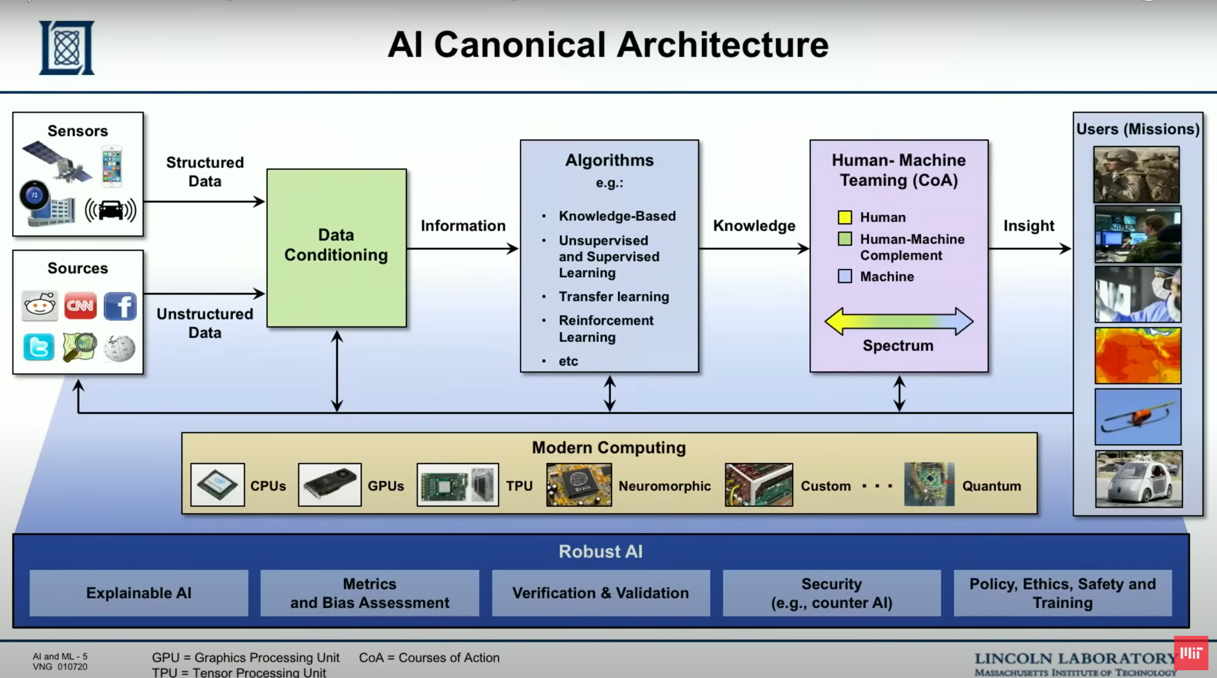
AI Canonical Structure
What is AI ?

Slide 6
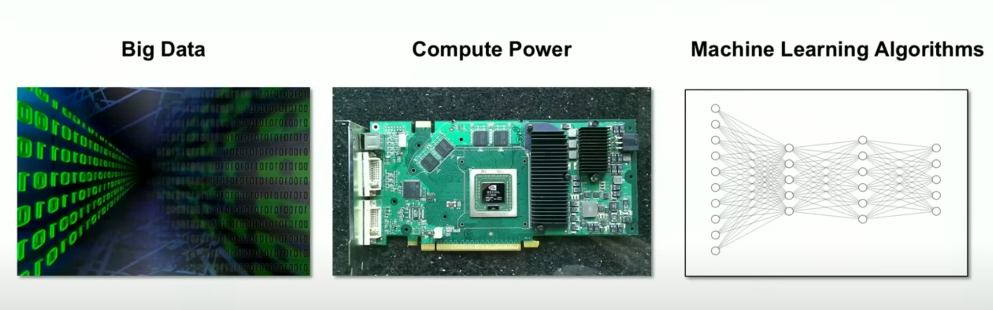

AI Current Rise
AI development enabled by advancements in Big Data, Hardware and Machine Learning Algorithms

Slide 7
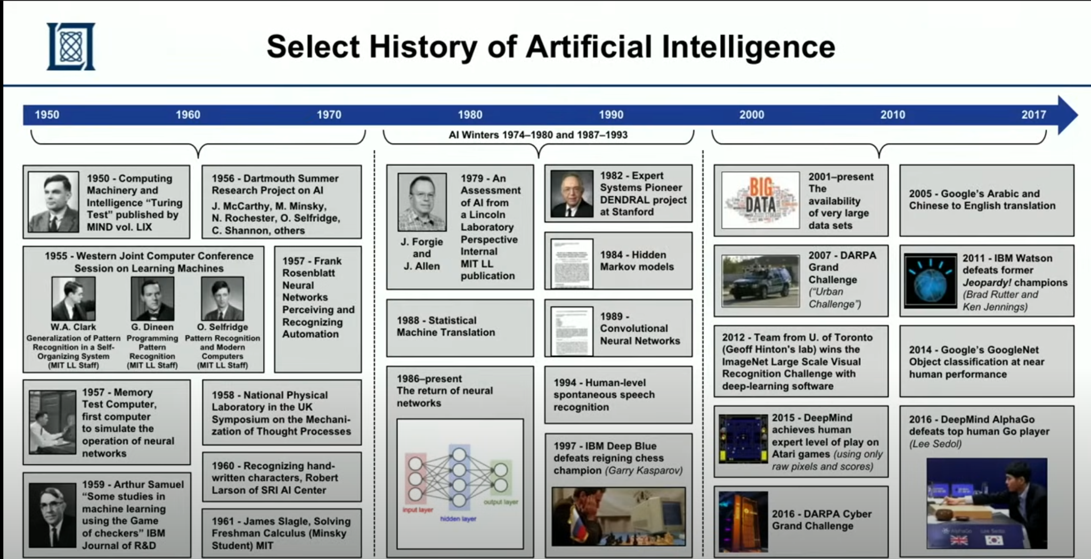
AI History

Slide 8
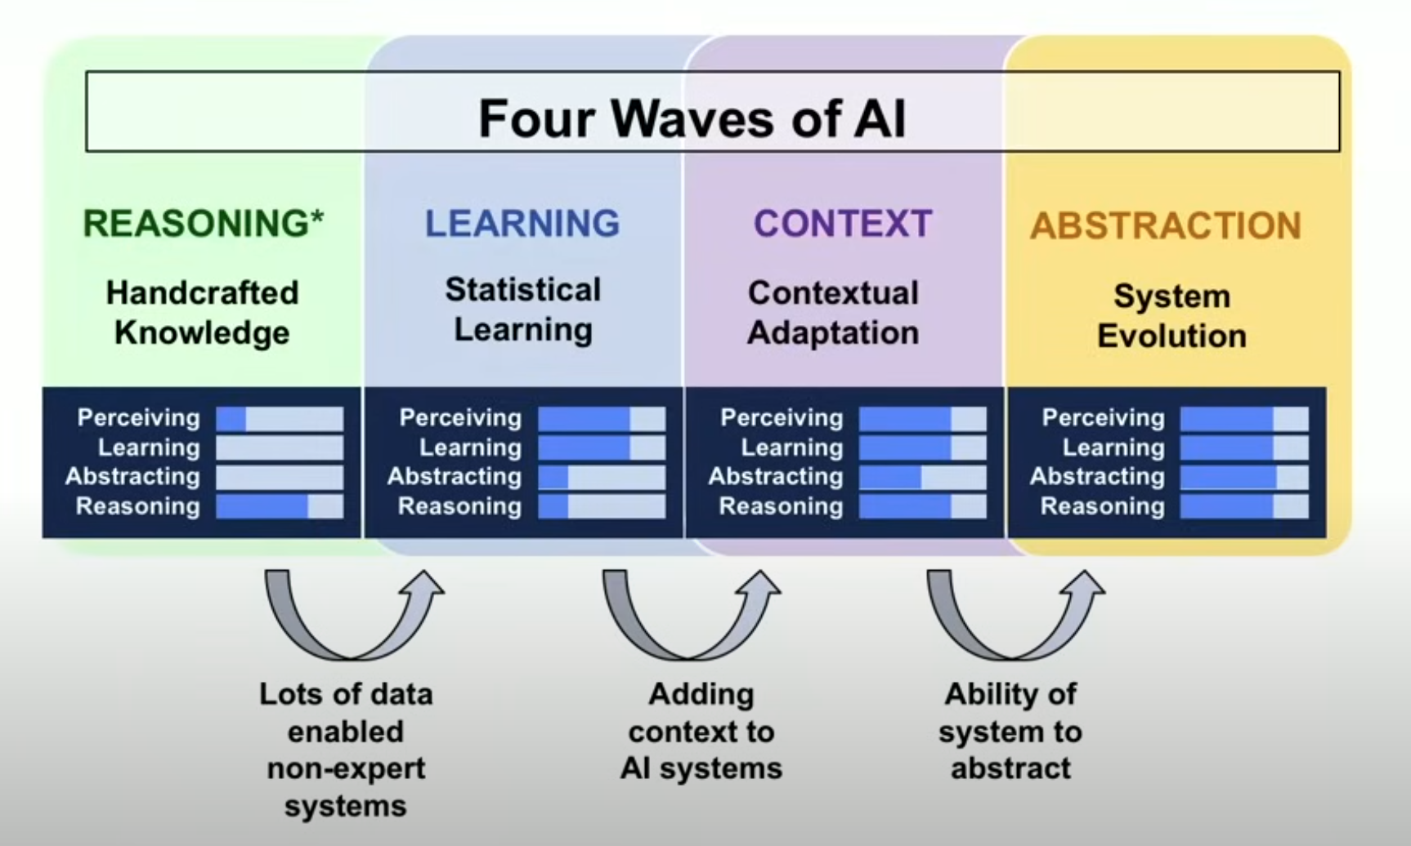
AI Advancement - 4 Waves of AI
Taken from DARPA, John Launchbury

Slide 9
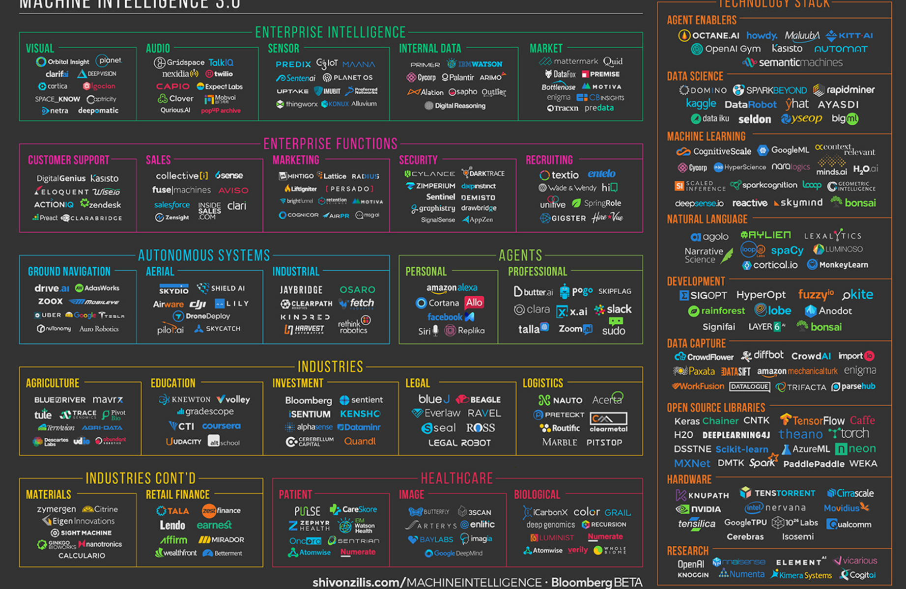
AI Commercial Uptake

Slide 10
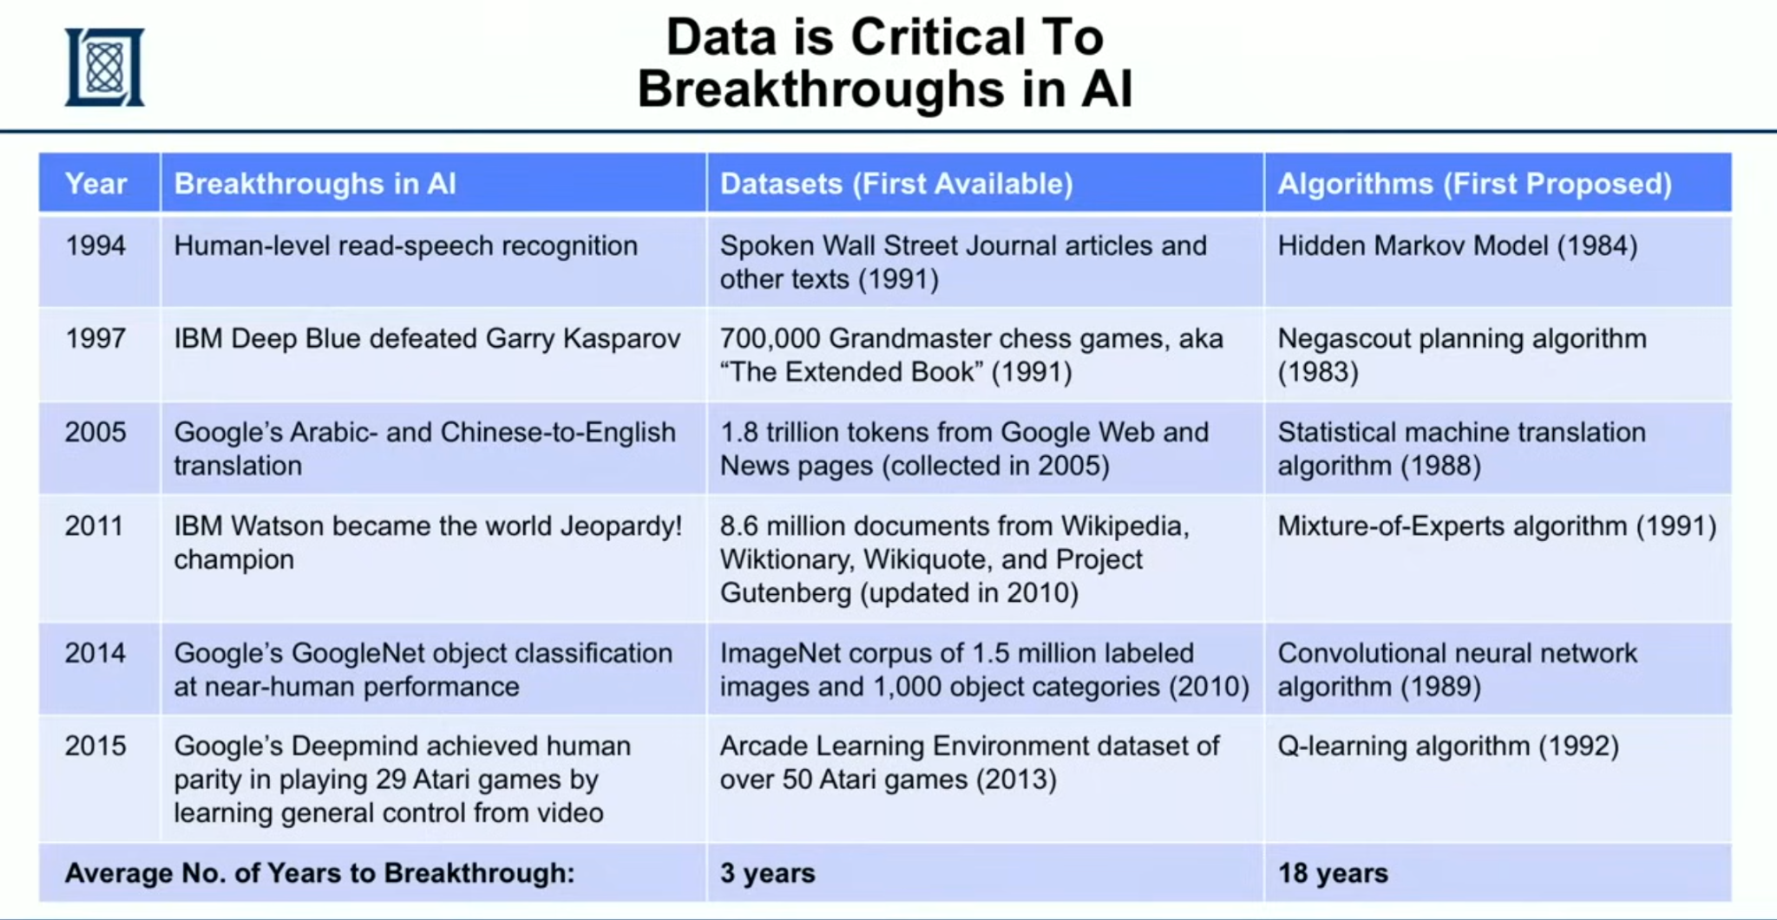
AI Breakthroughs , Data

Slide 11
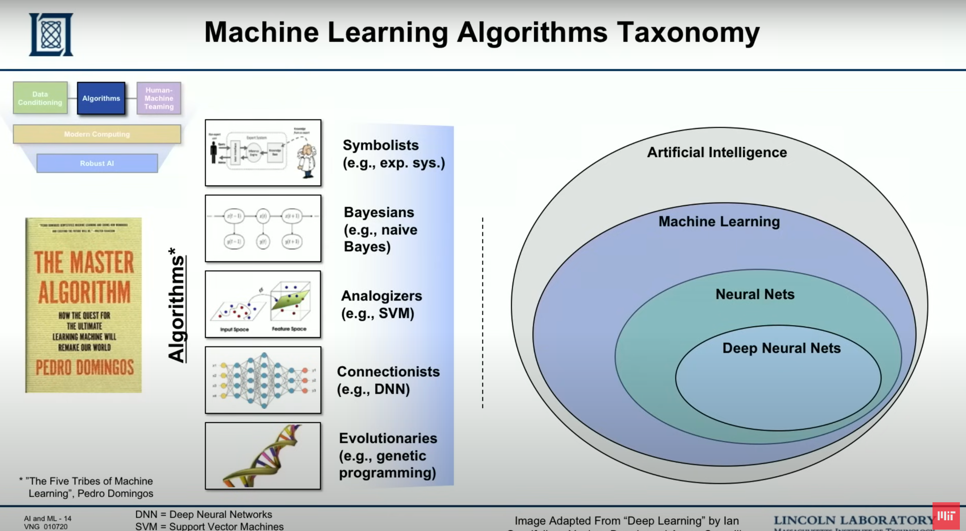
ML Algorithm Taxonomy

Slide 12
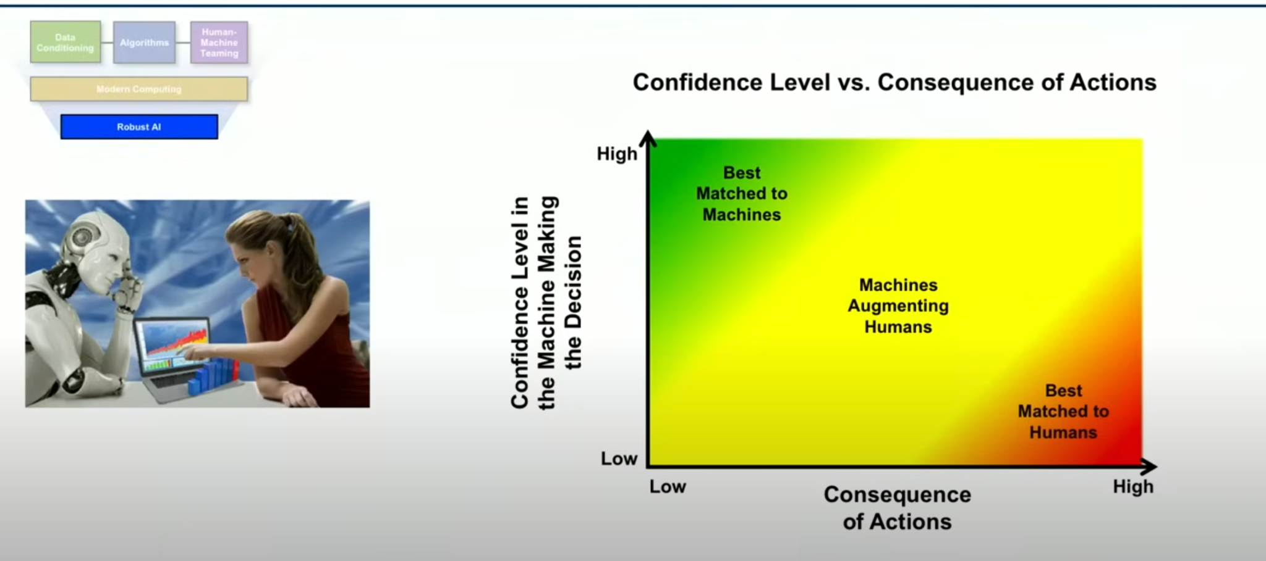
Building Robust AI

Slide 13
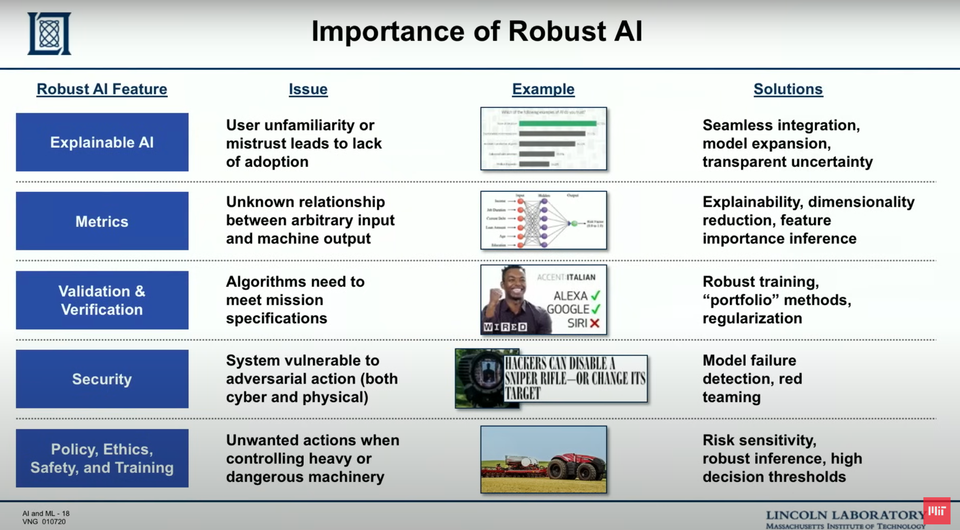
Importance of Robust AI

Slide 14
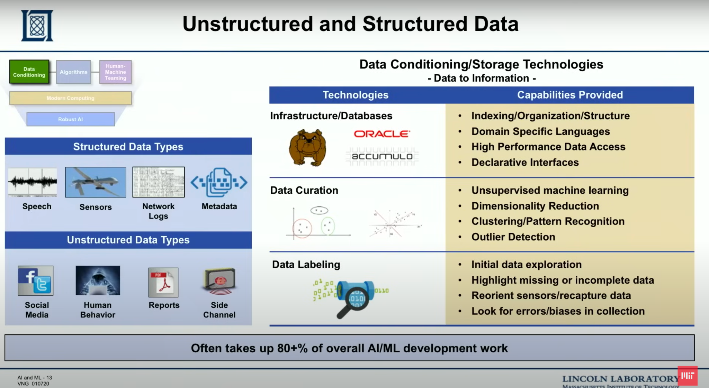
Datasets in ML: Unstructured v/s Structured

Slide 15
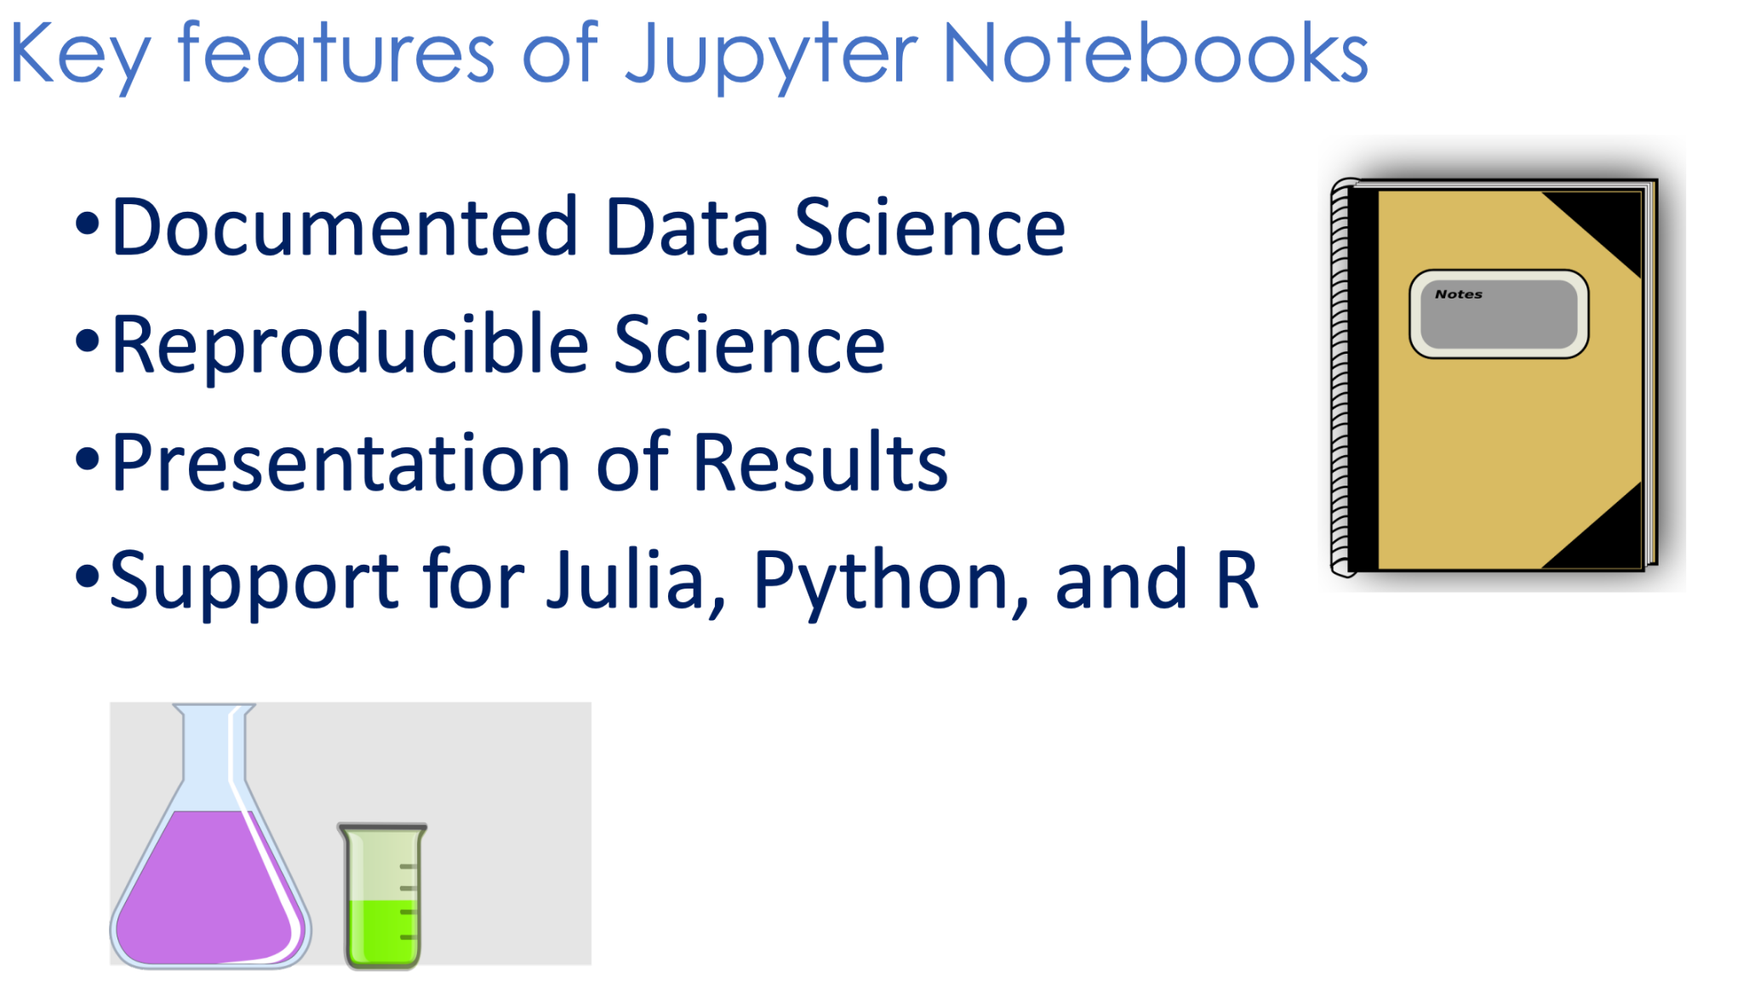
Jupyter Notebook

Slide 16
Python Libraries used in ML
Topics covered
Pandas
NumPy
Scikit-learn
Matplotlib
Biopython

Slide 17
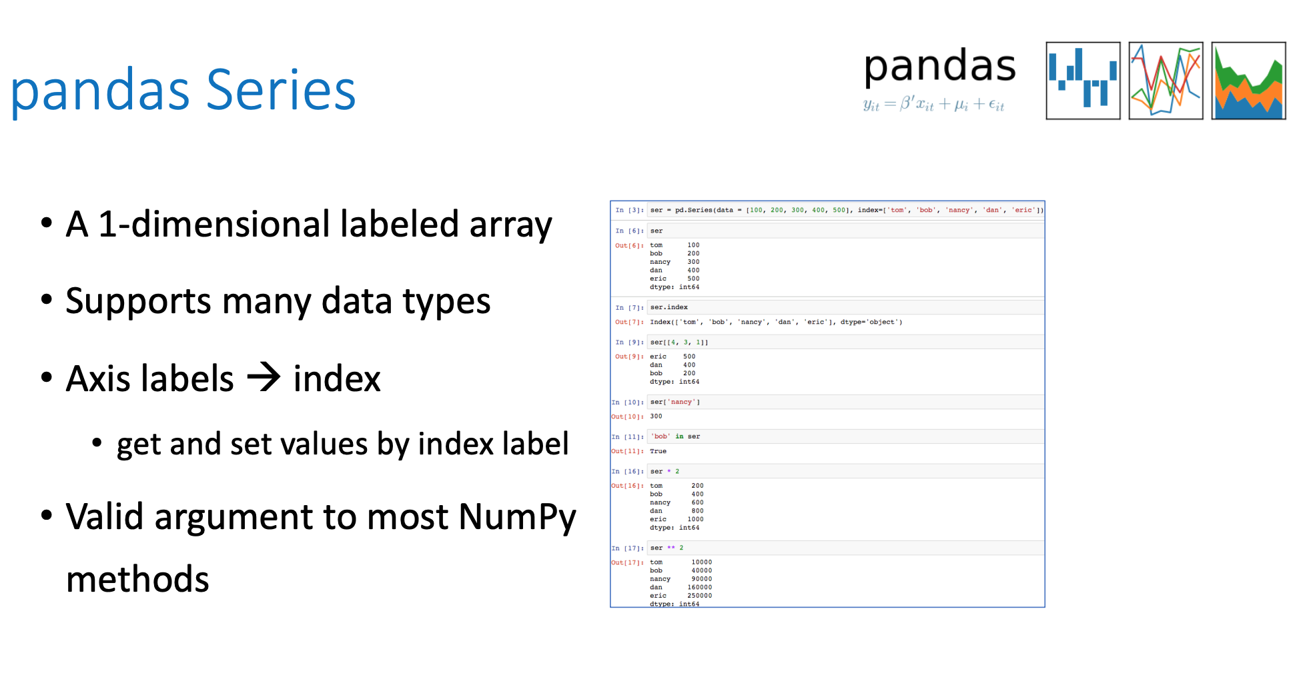

Slide 18
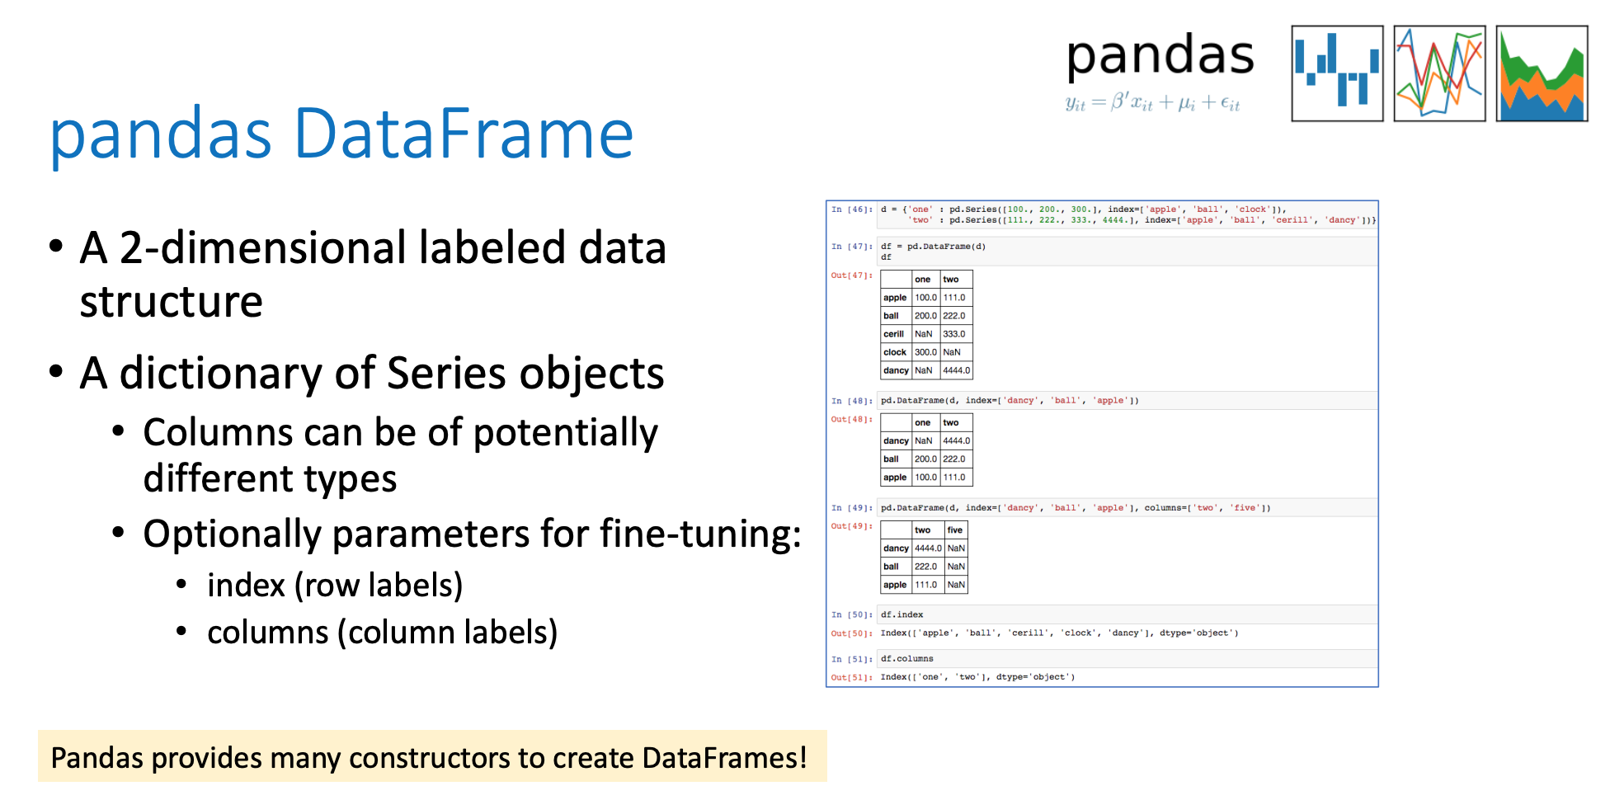

Slide 19
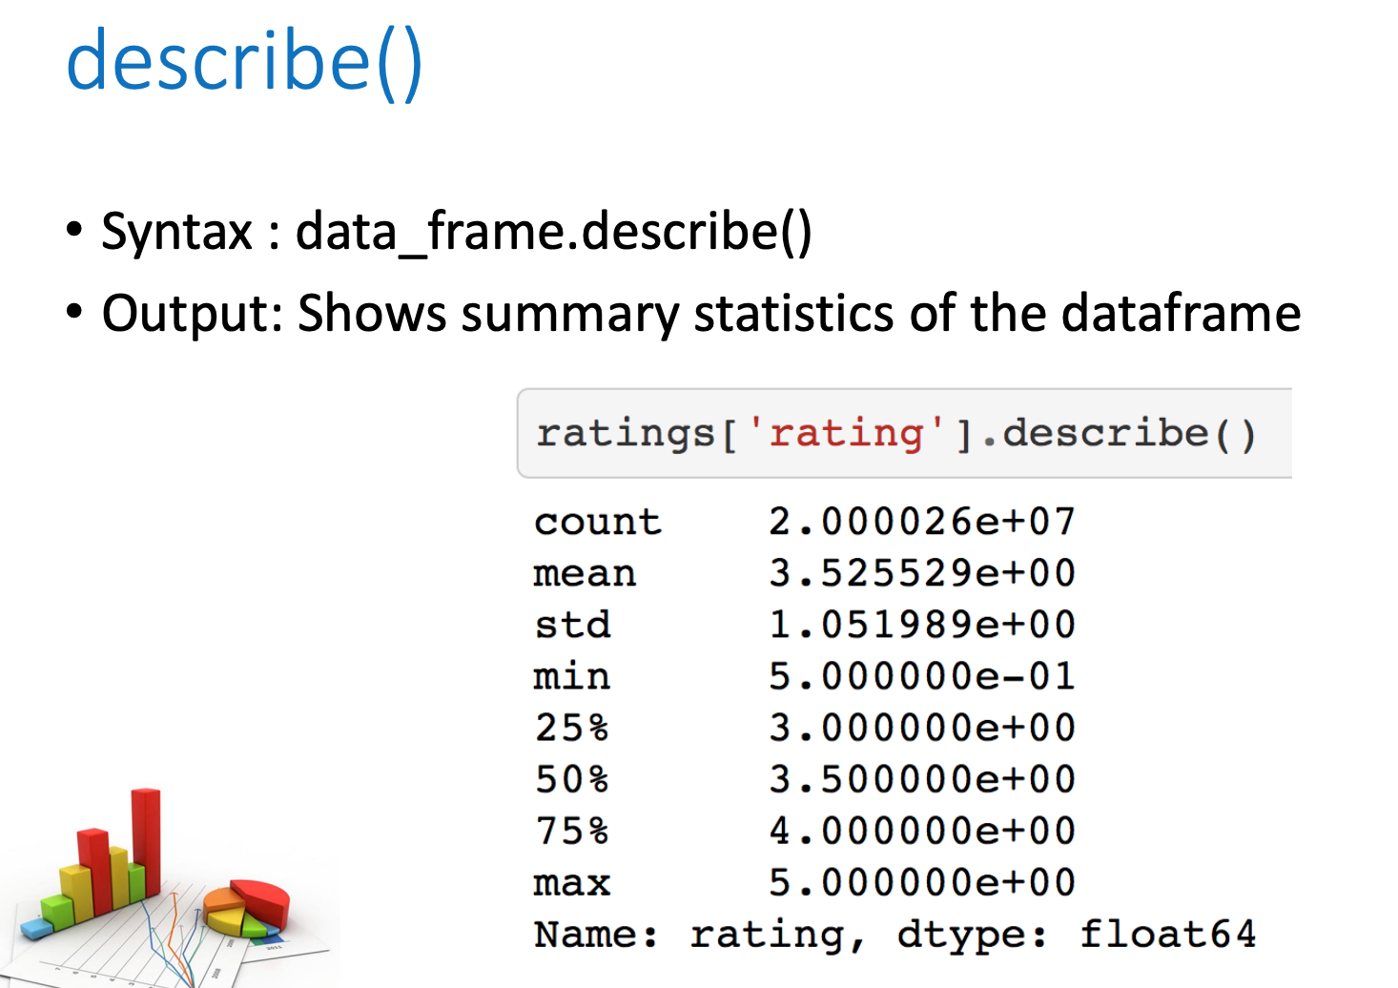

Slide 20
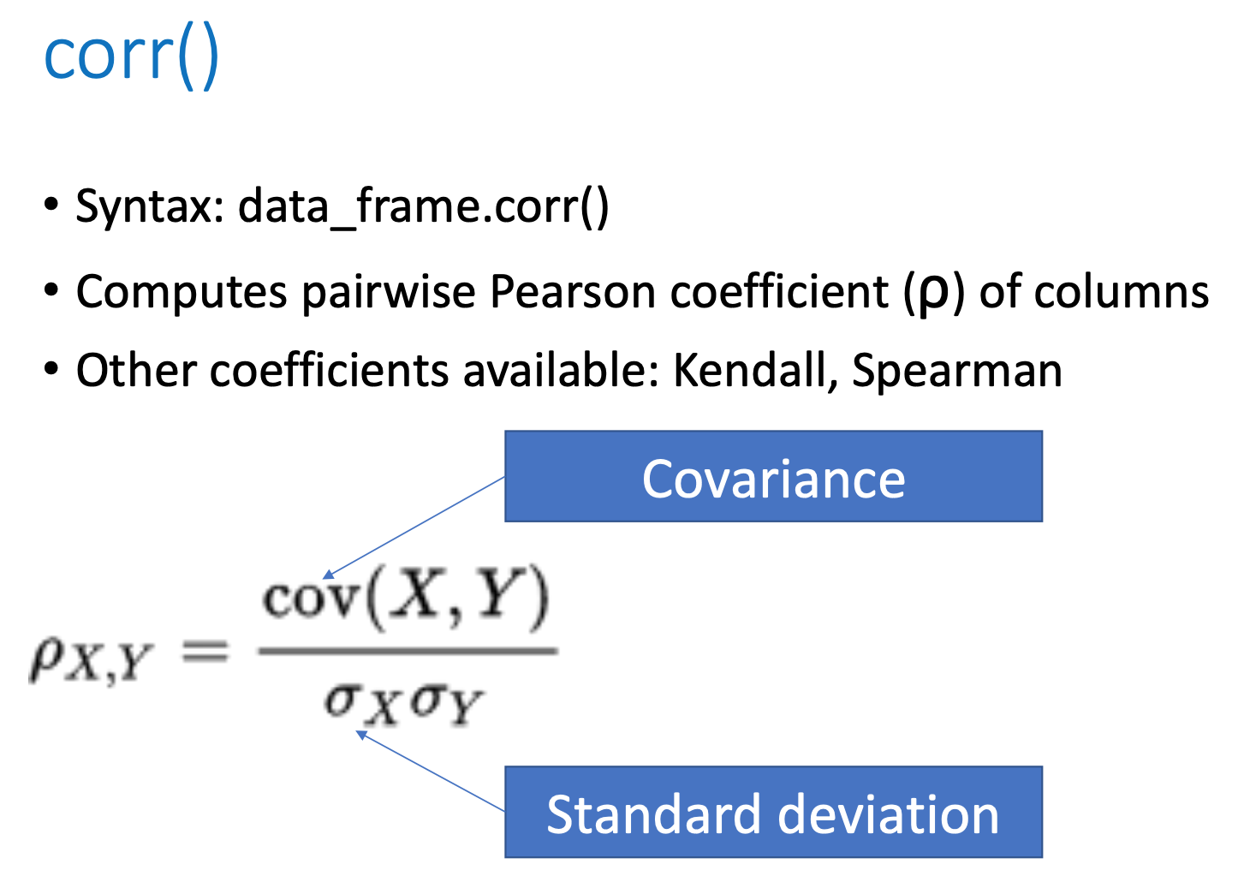

Slide 21
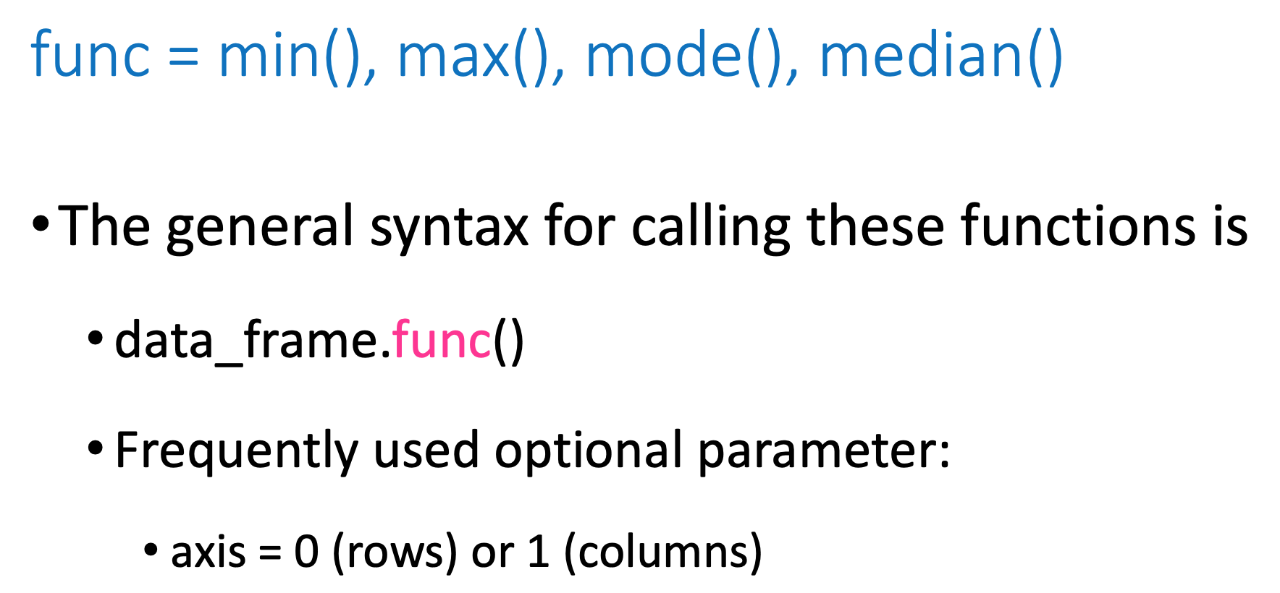

Slide 22
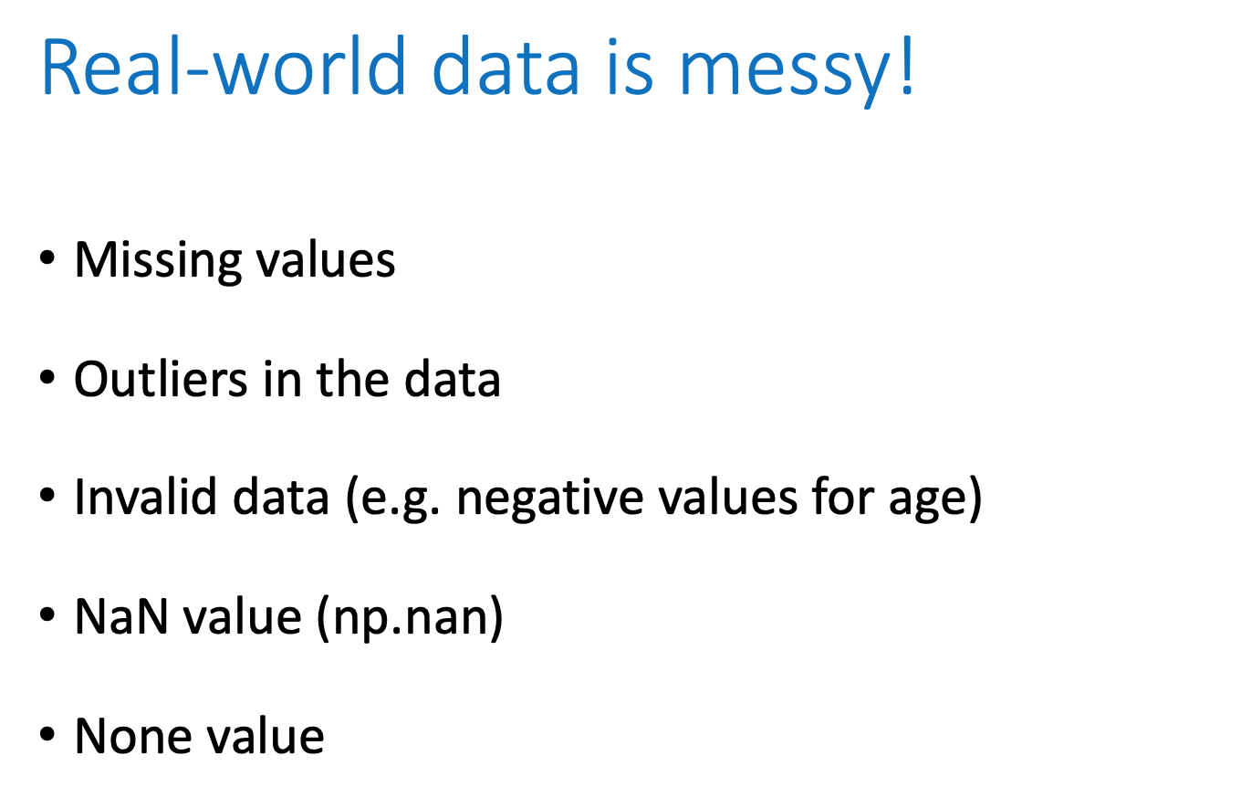

Slide 23
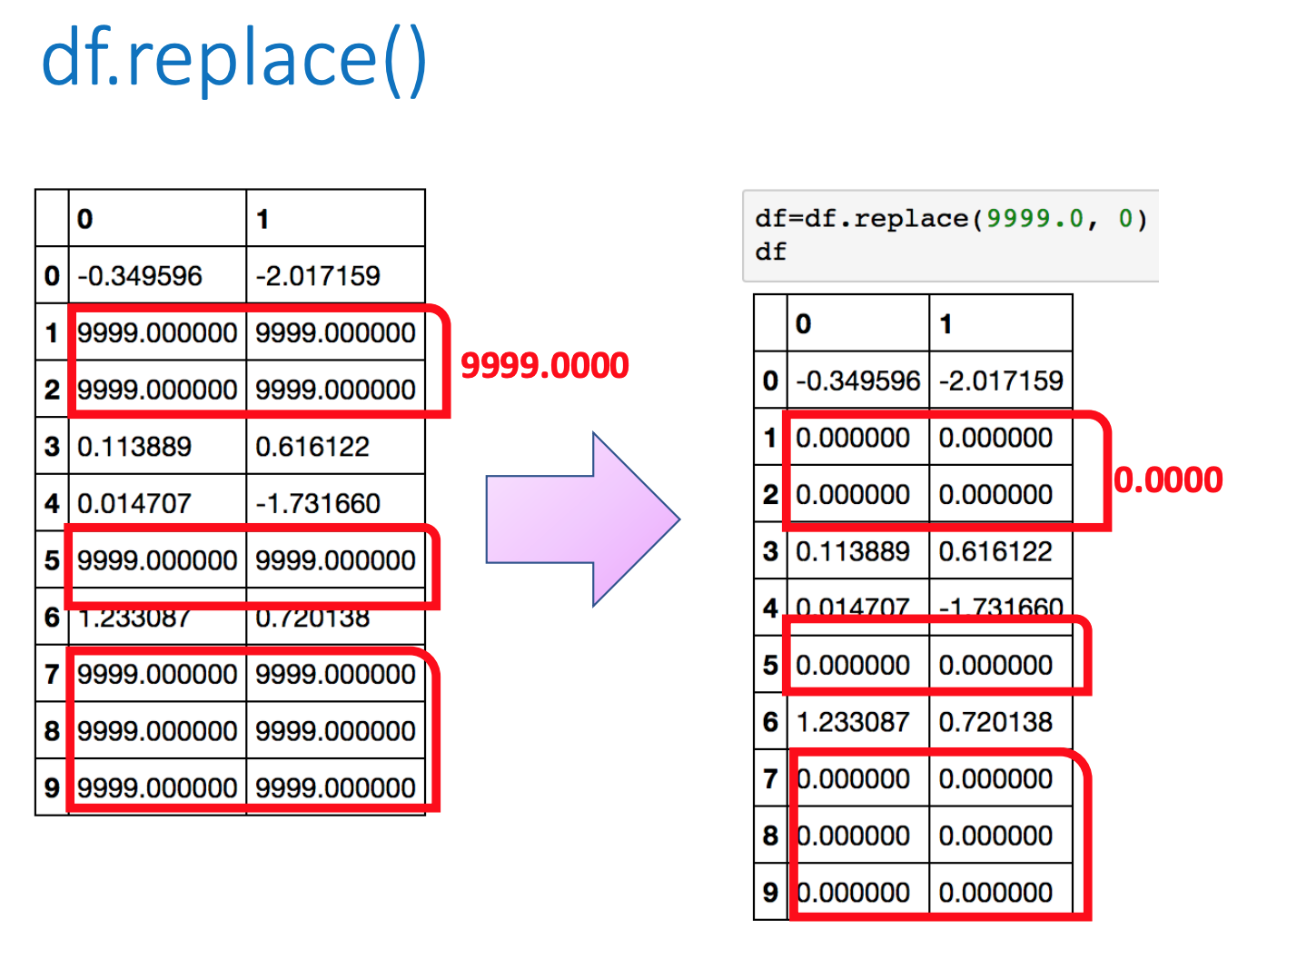

Slide 24
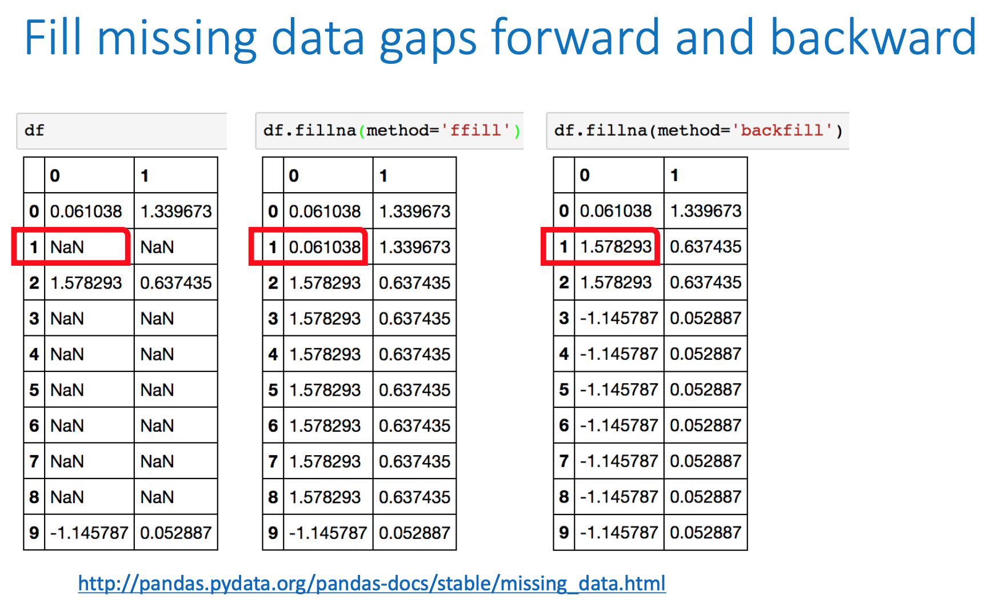

Slide 25
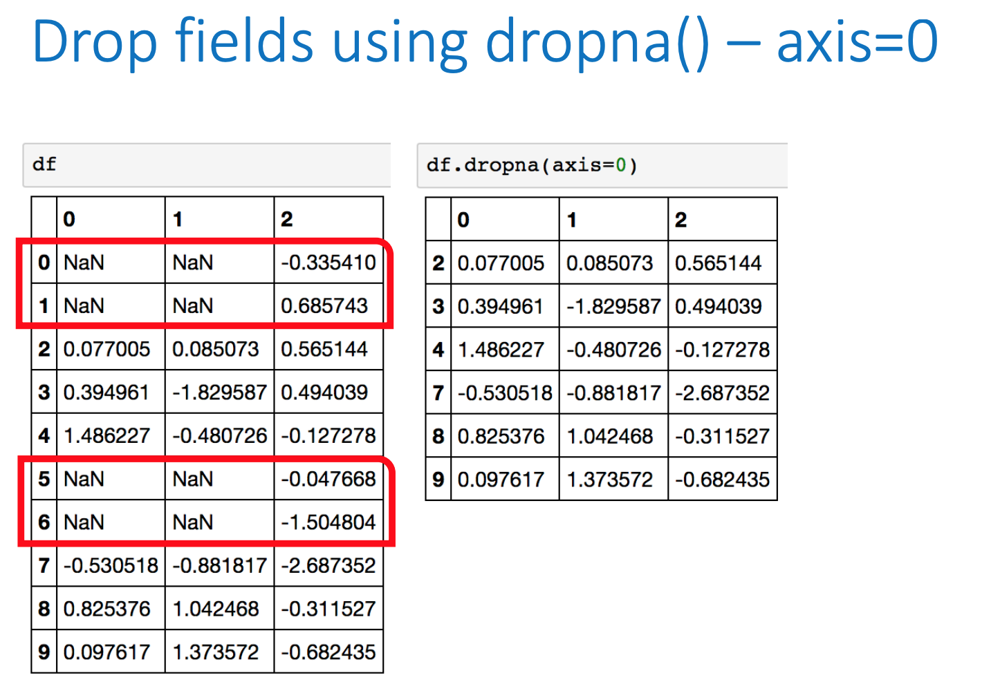

Slide 26
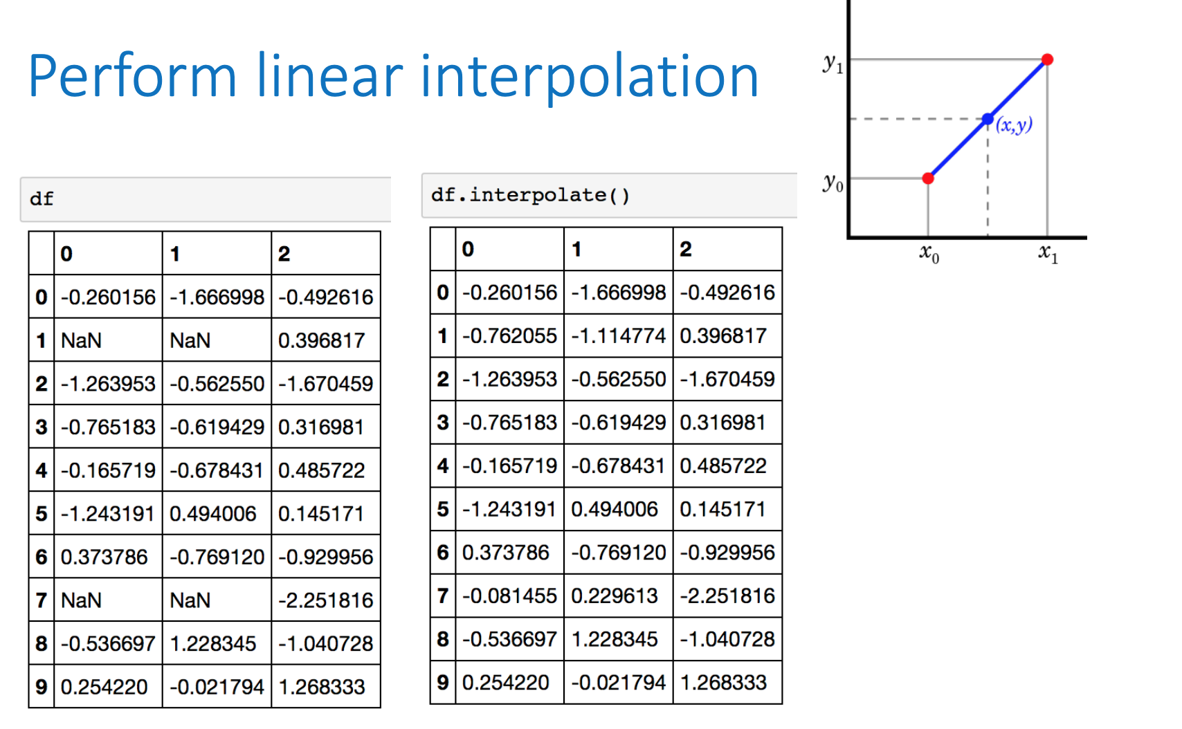

Slide 27
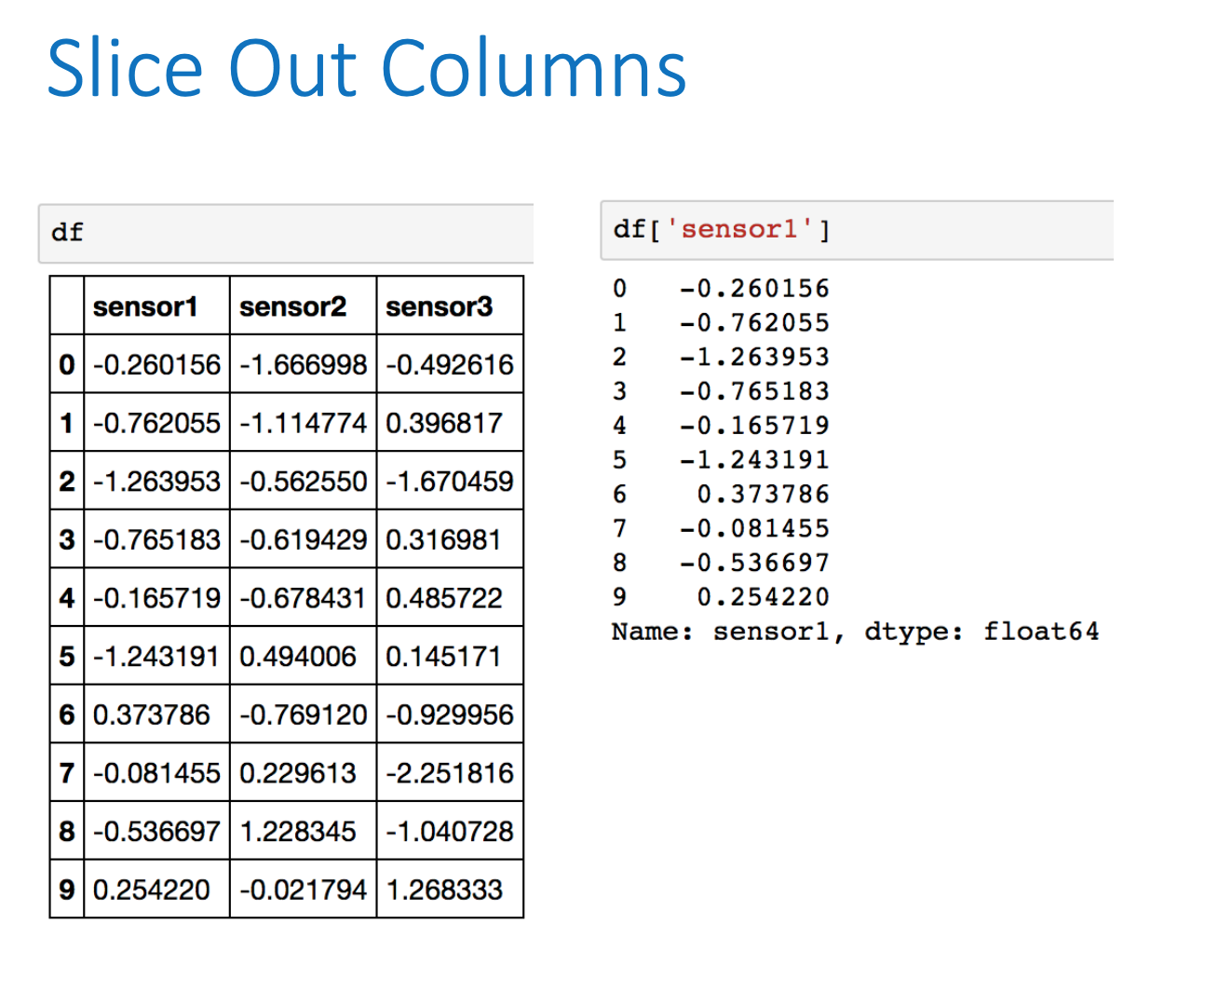

Slide 28
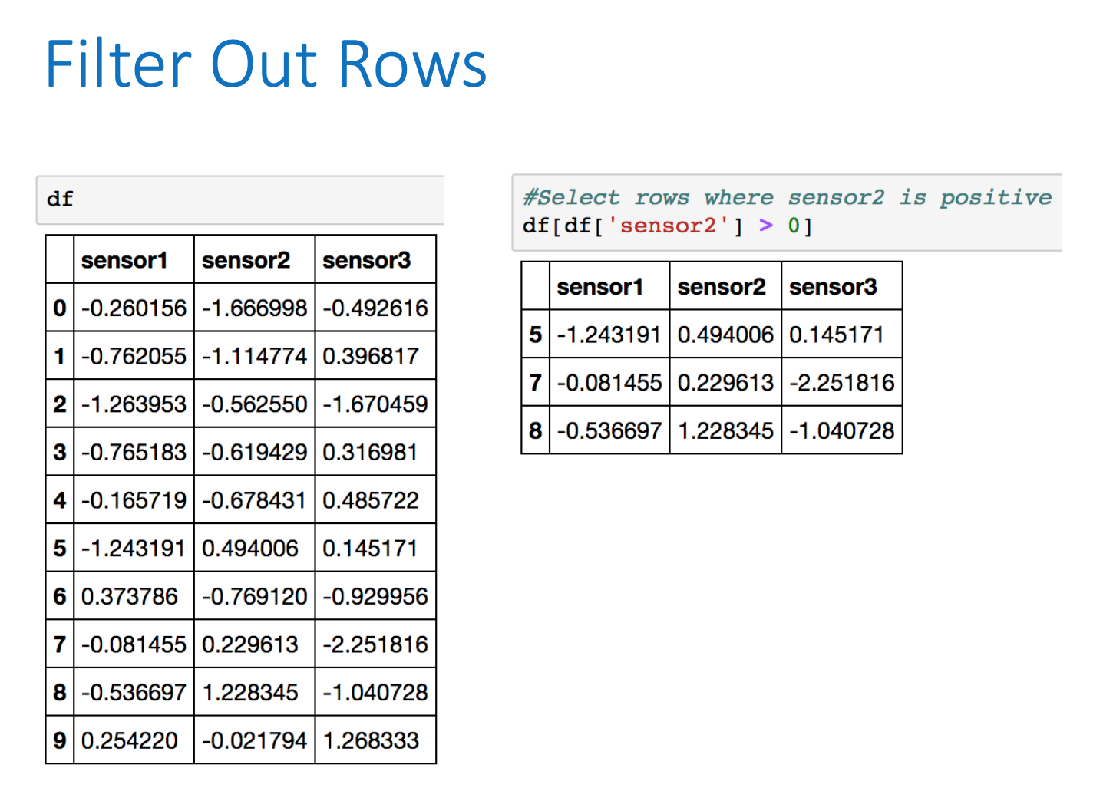

Slide 29
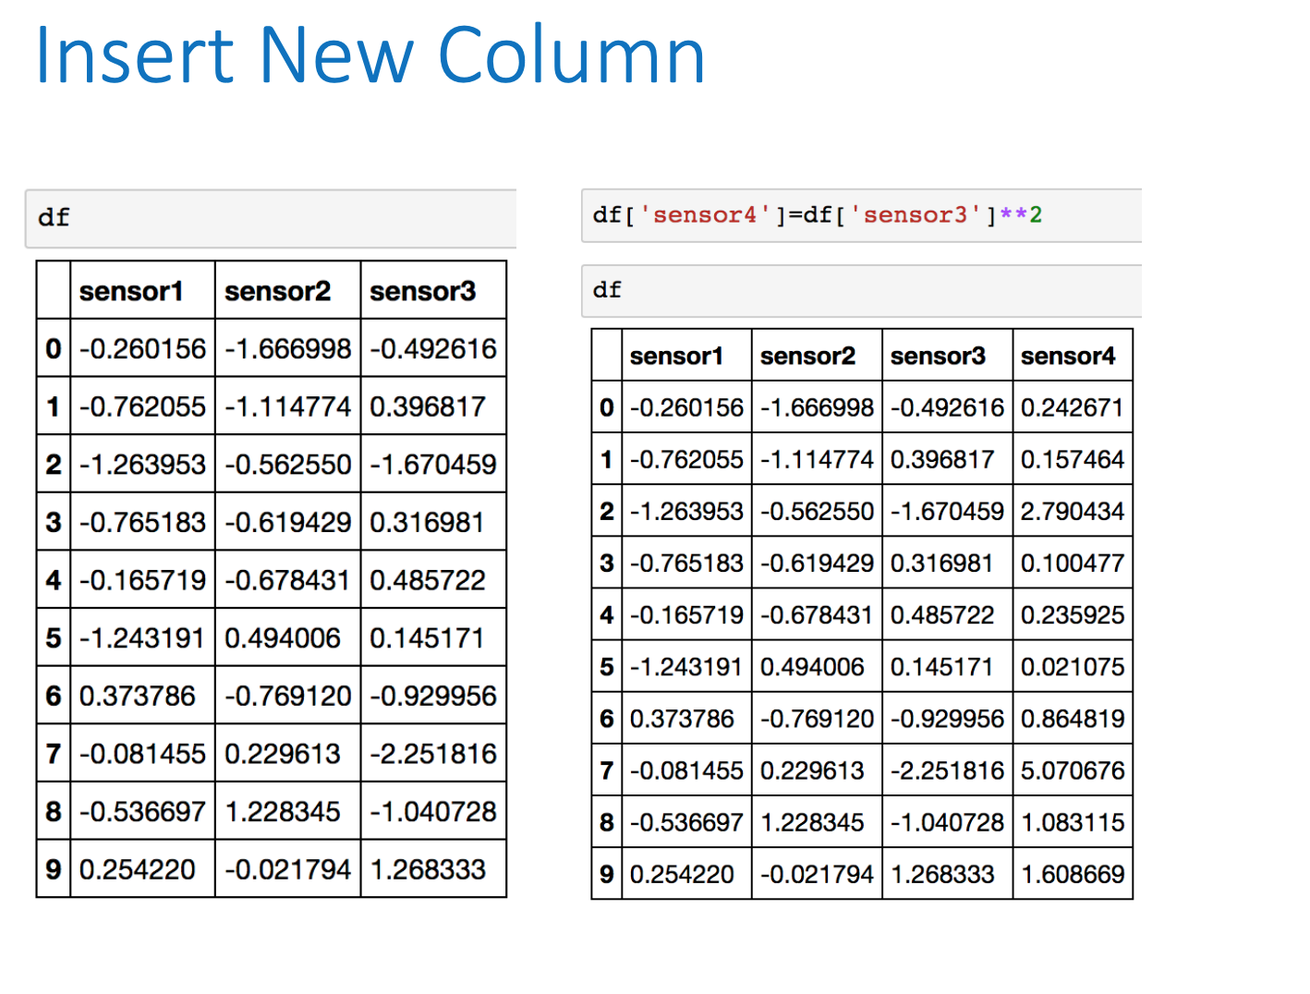

Slide 30
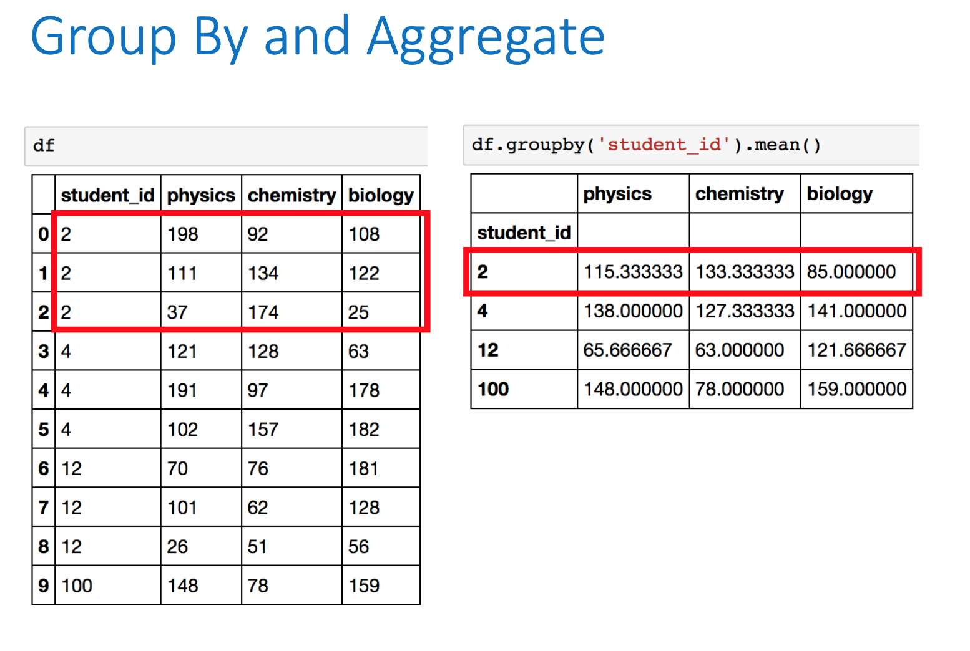

Slide 31
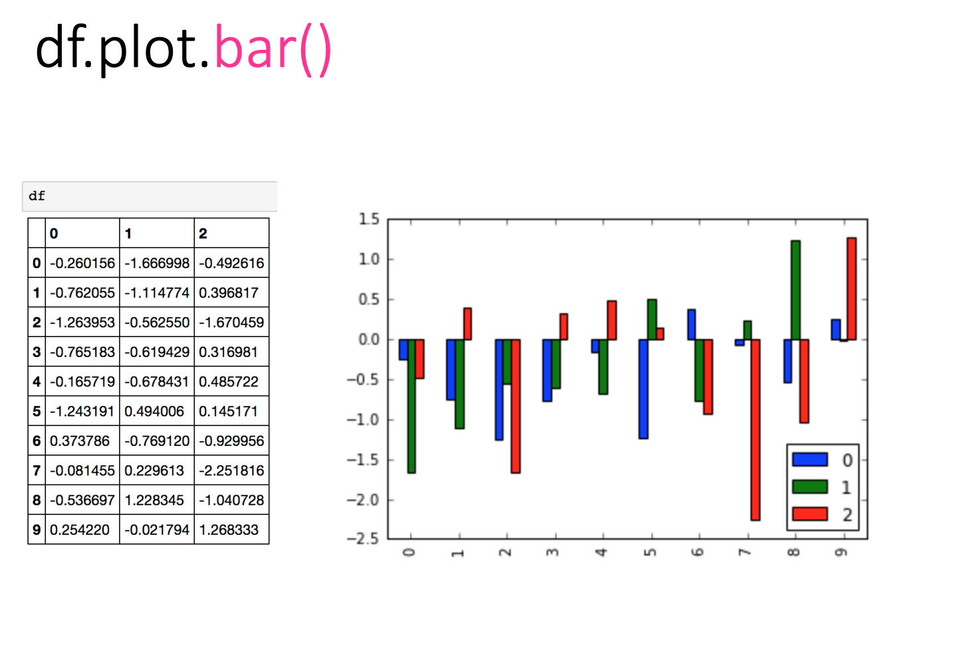

Slide 32
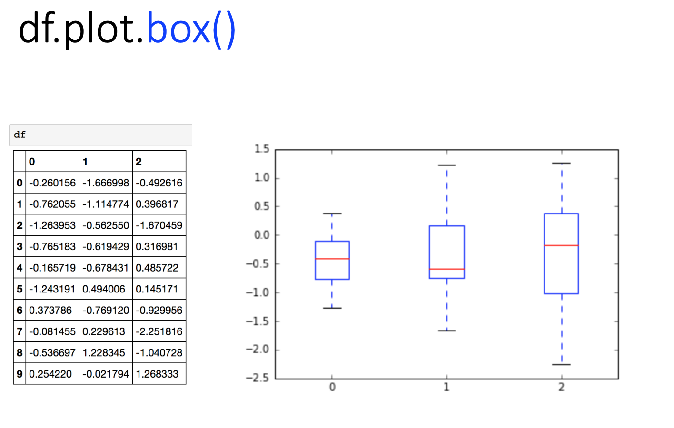

Slide 33
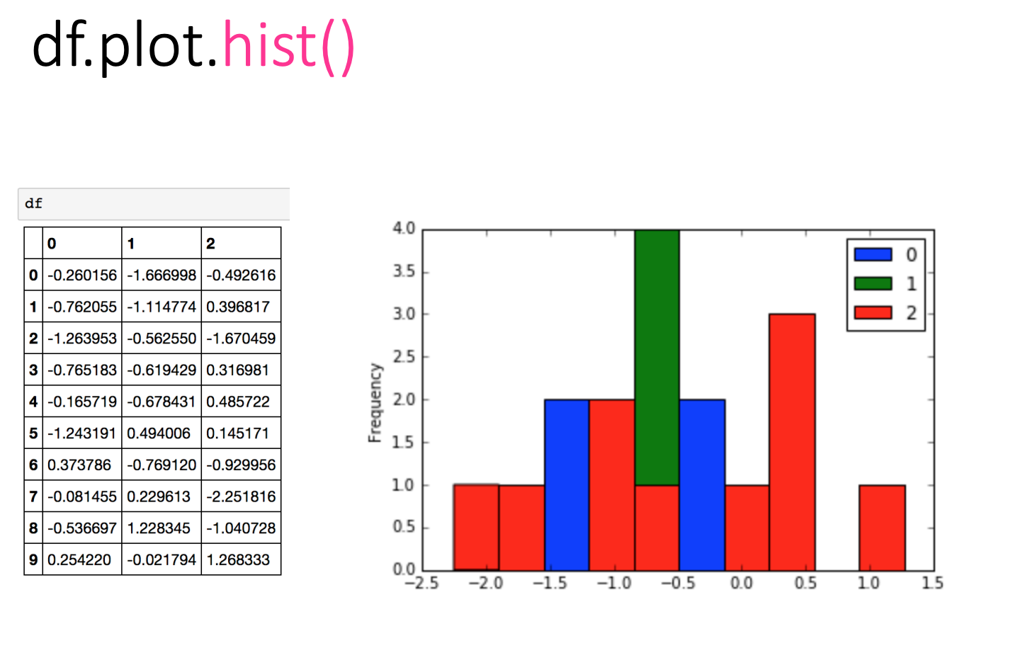

Slide 34
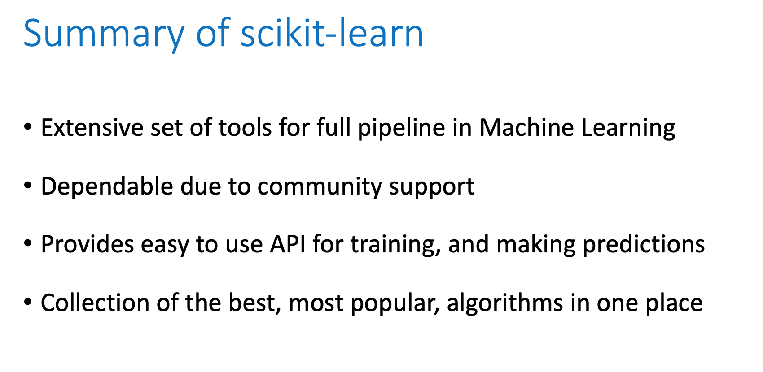

Slide 35
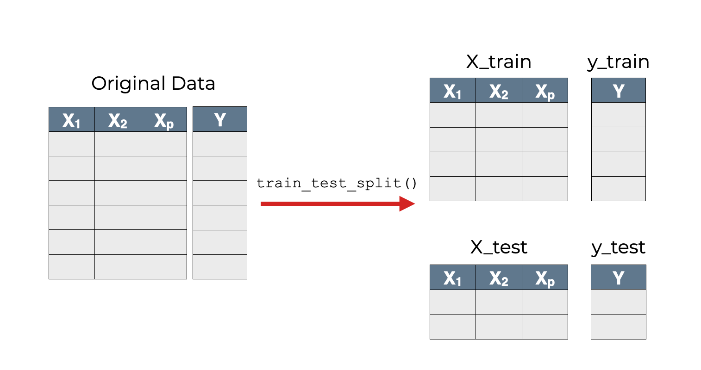

Slide 36
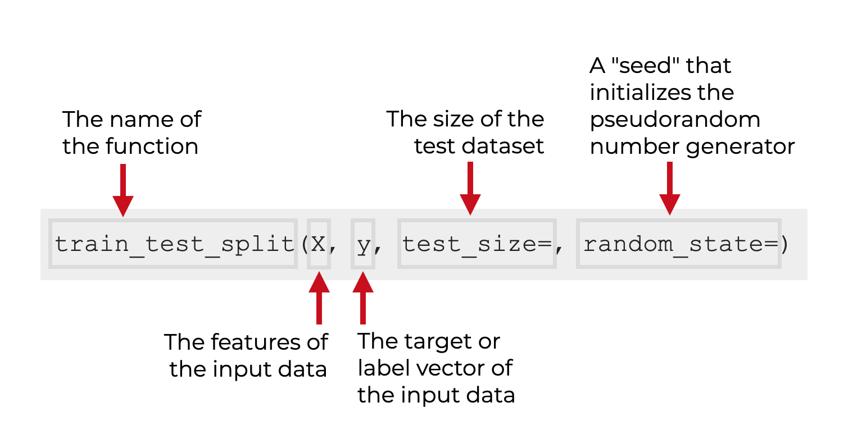

Slide 37
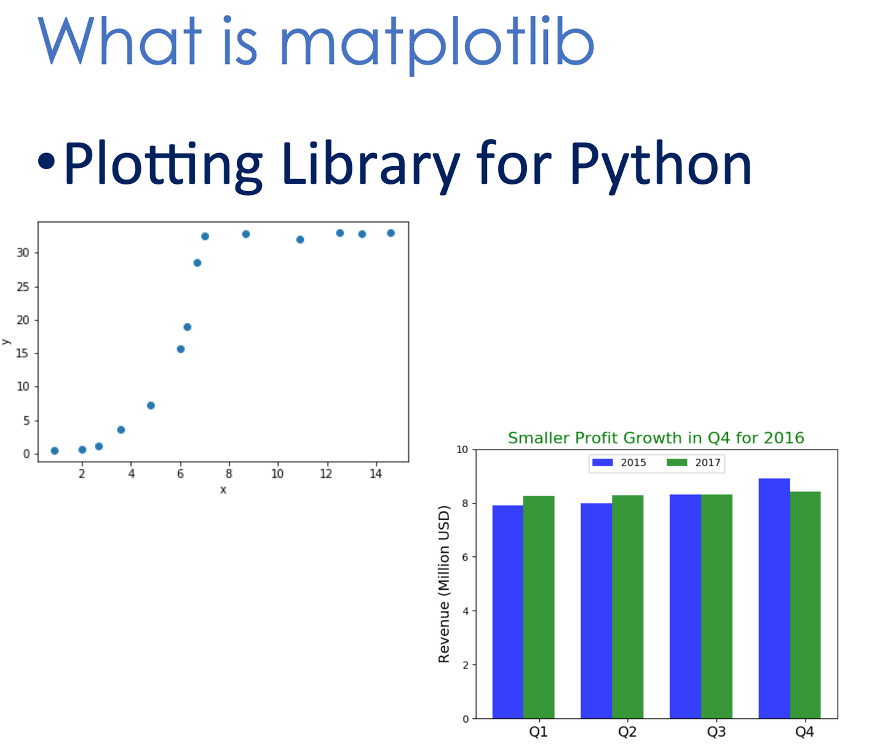

Slide 38
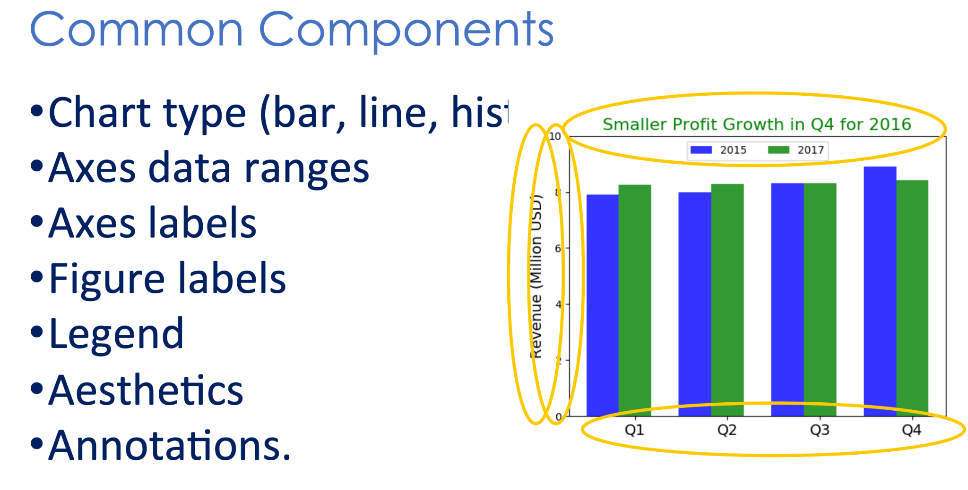

Slide 39
Lab Session
LAB 1 - Protein analysis using ESMFold LLM
First notebook
Second notebook

Slide 40
Lab Session
LAB 2 - Physicochemical Properties Analysis of Protein Sequence Data
https://colab.research.google.com/drive/1mdL5pJHk7IJZKC893MtemXI9Dqt_0Xug?usp=sharing

Slide 41
Lunch
See you back in 1 hr

Slide 42
Linear Regression
Topics covered
Regression Explained
Regression with multiple predictor variables
Least-squares regression
The least-squares solution
Performance evaluation; Mean Square Error (MSE) , Mean Absolute Error (MAE) , Root Mean Squared Error (RMSE) and R2 score

Slide 43
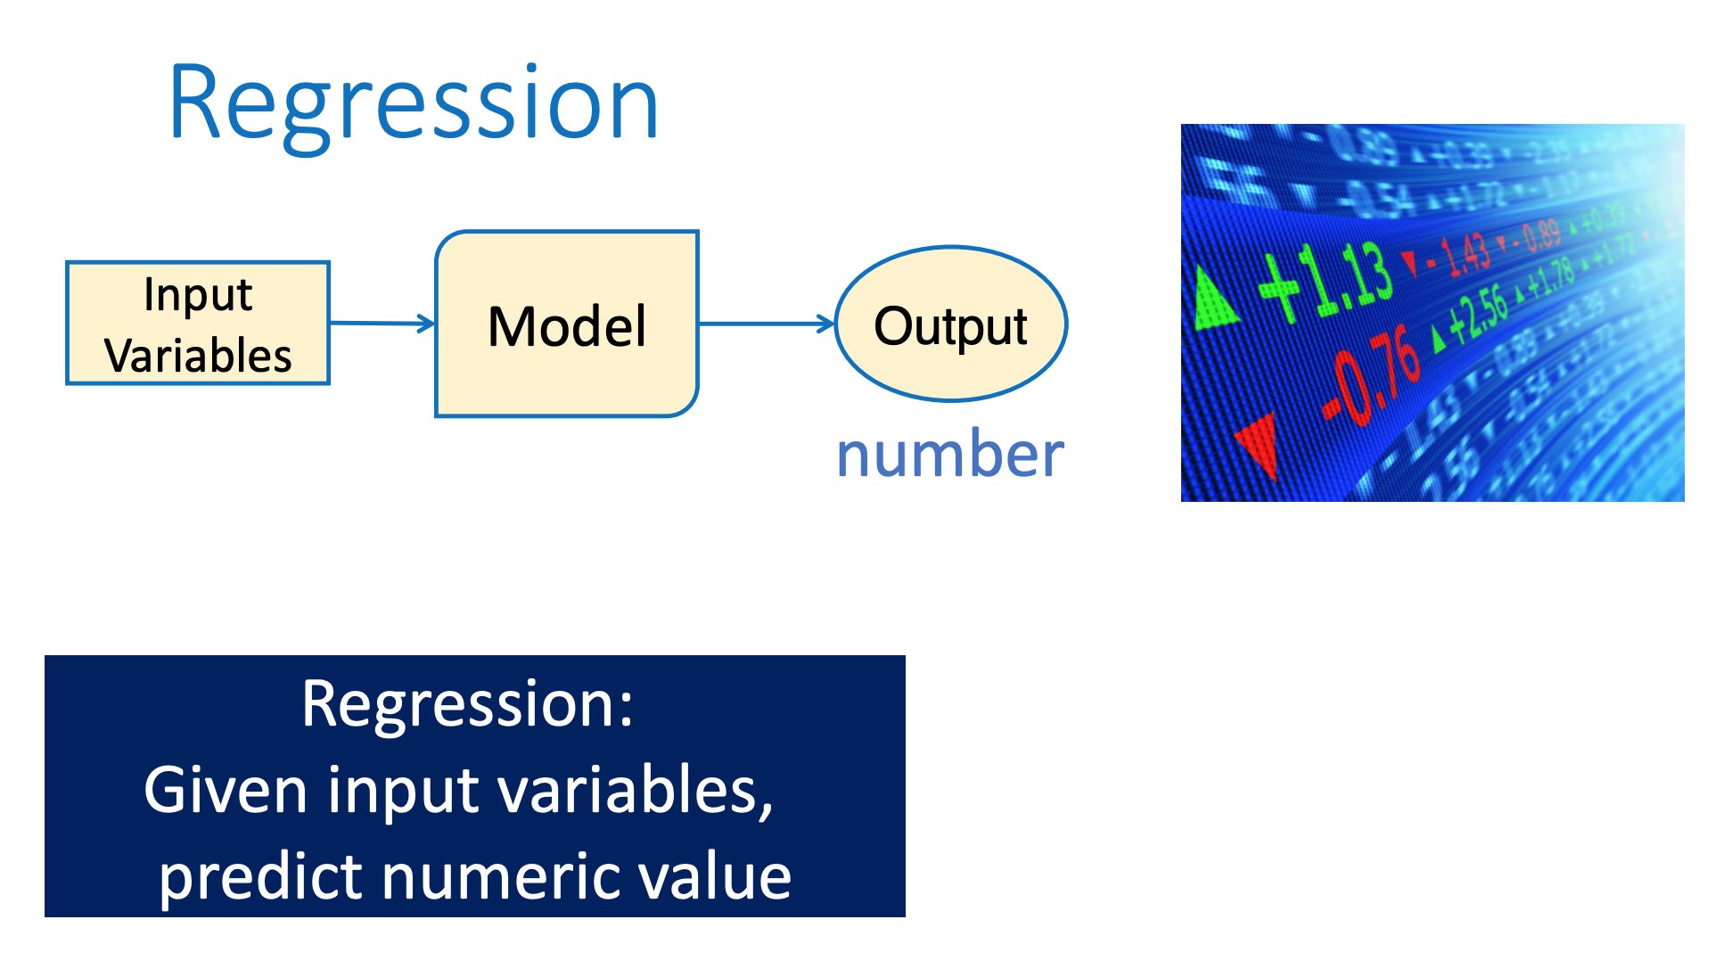

Slide 44
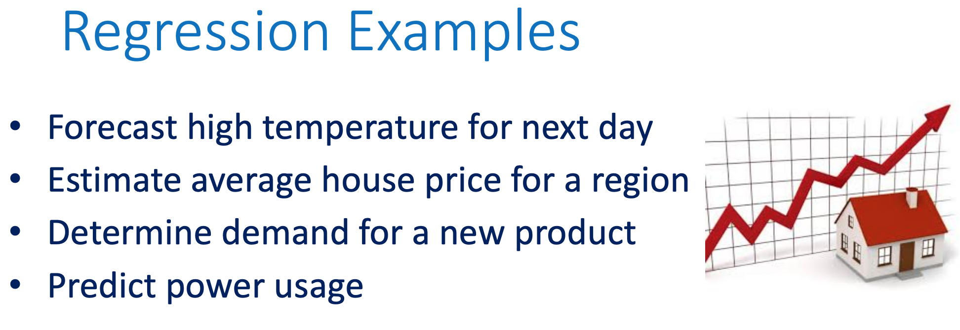

Slide 45
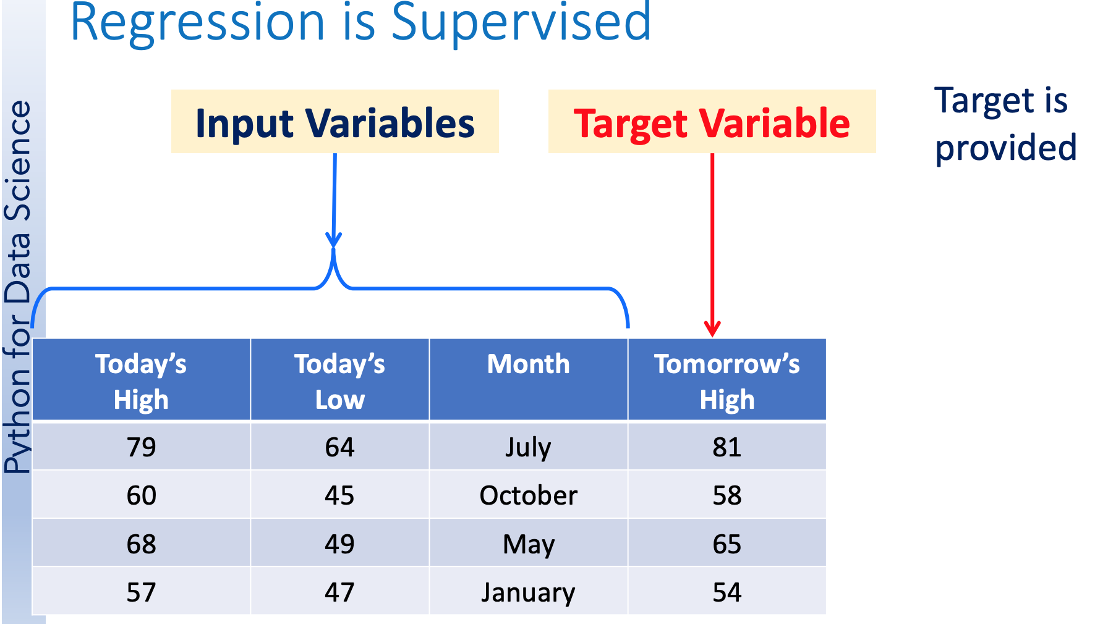

Slide 46
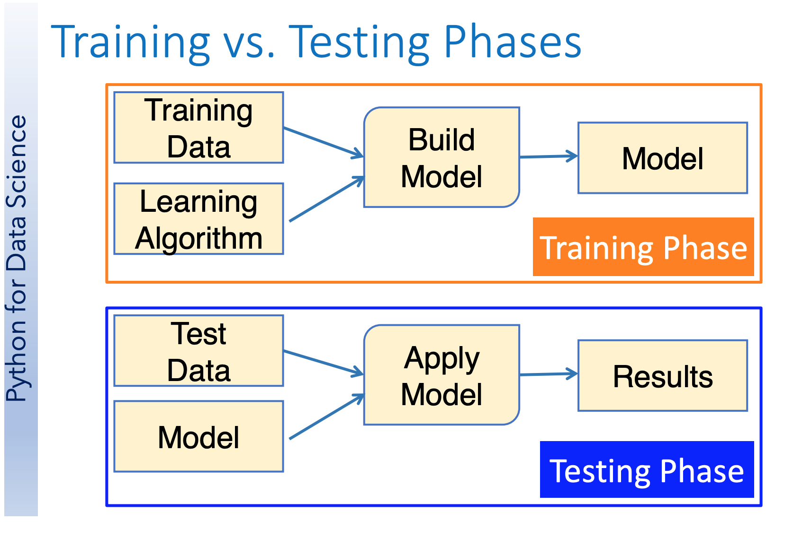

Slide 47
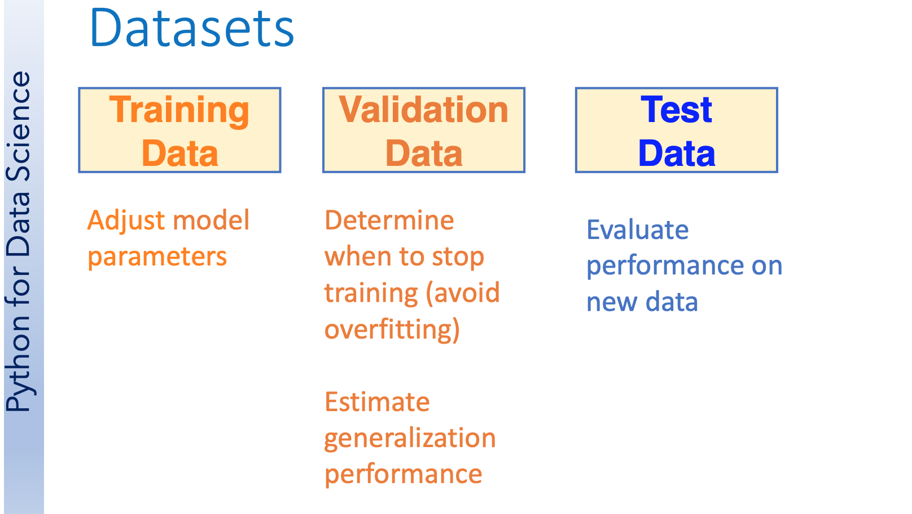

Slide 48
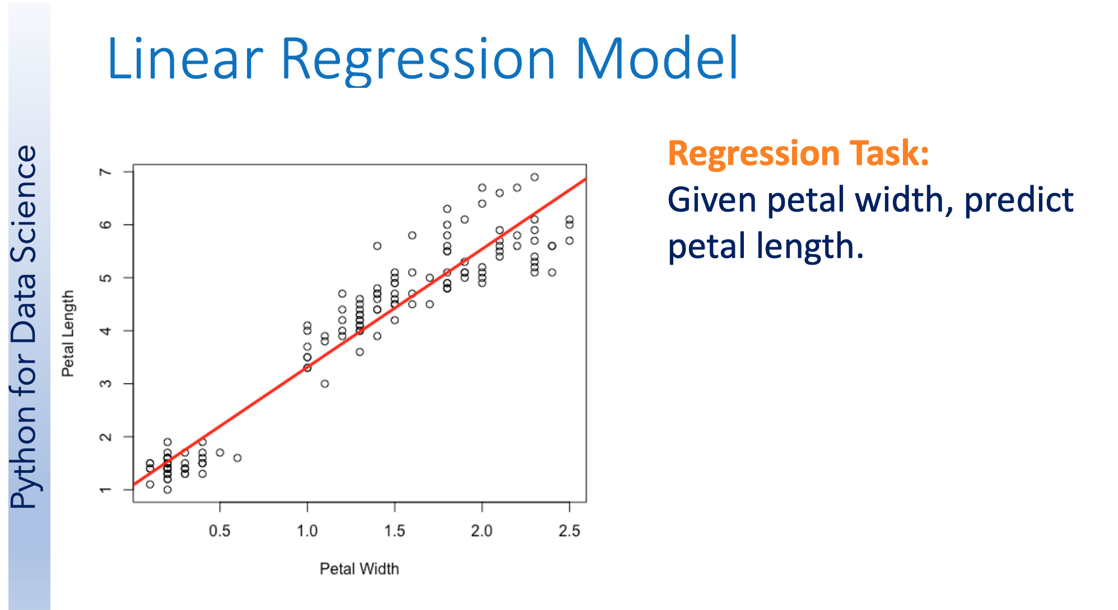

Slide 49
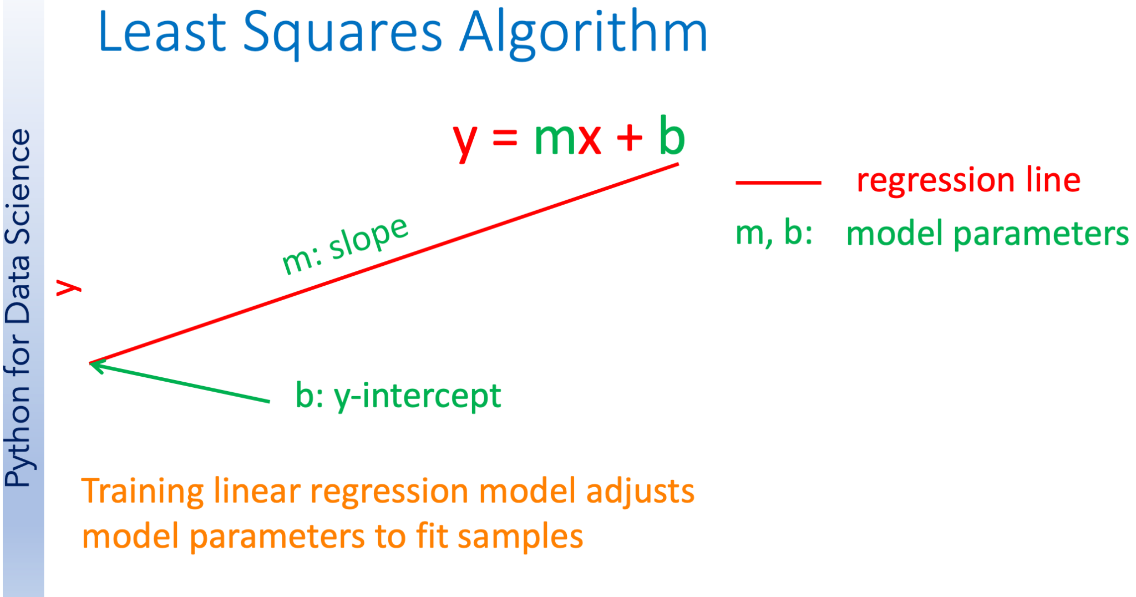

Slide 50
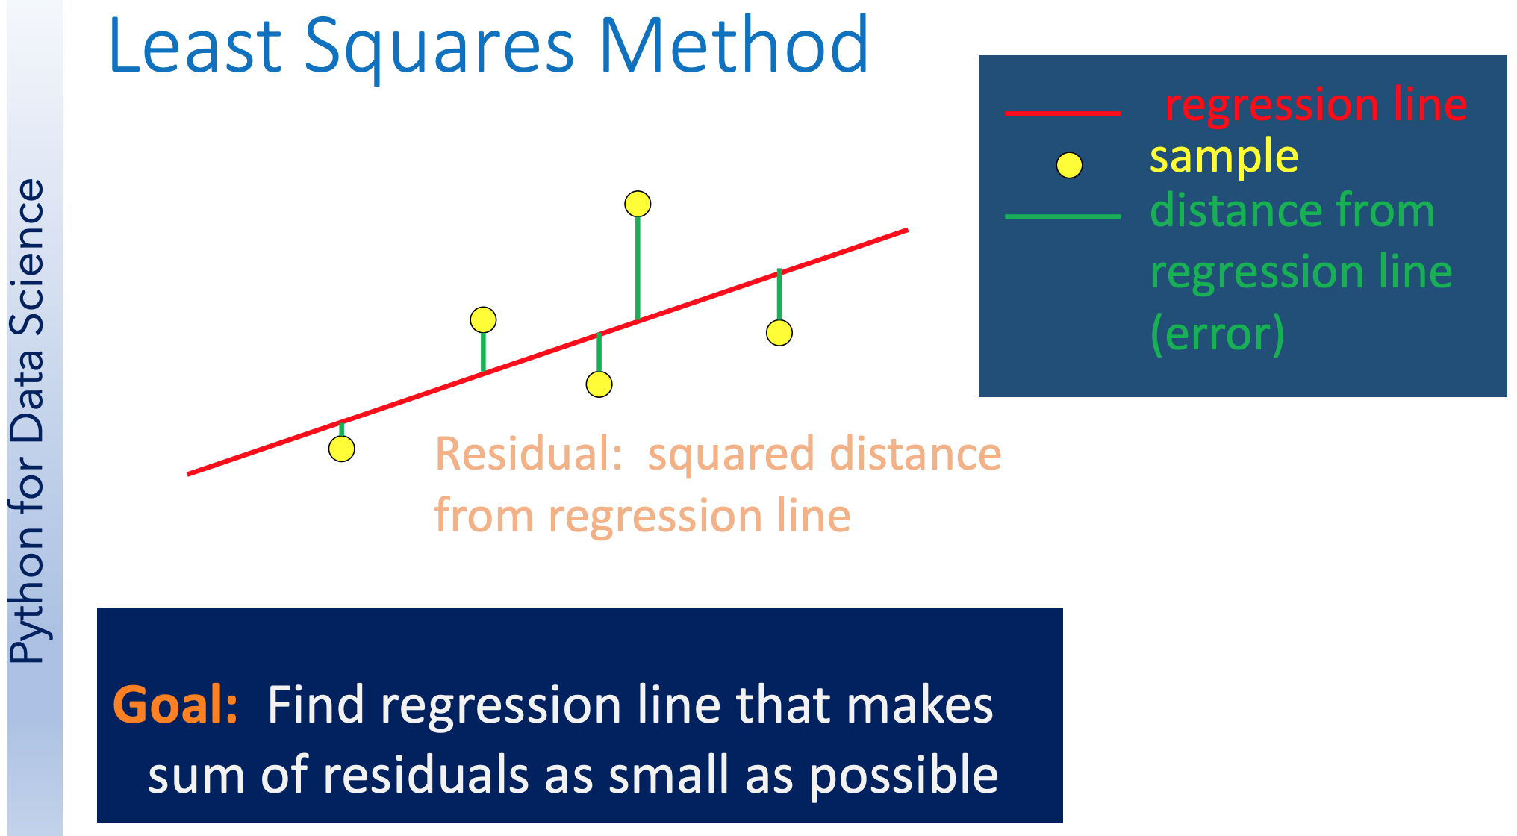

Slide 51
Linear Regression - Line Fitting
Whiteboard
https://lucid.app/lucidspark

Slide 52
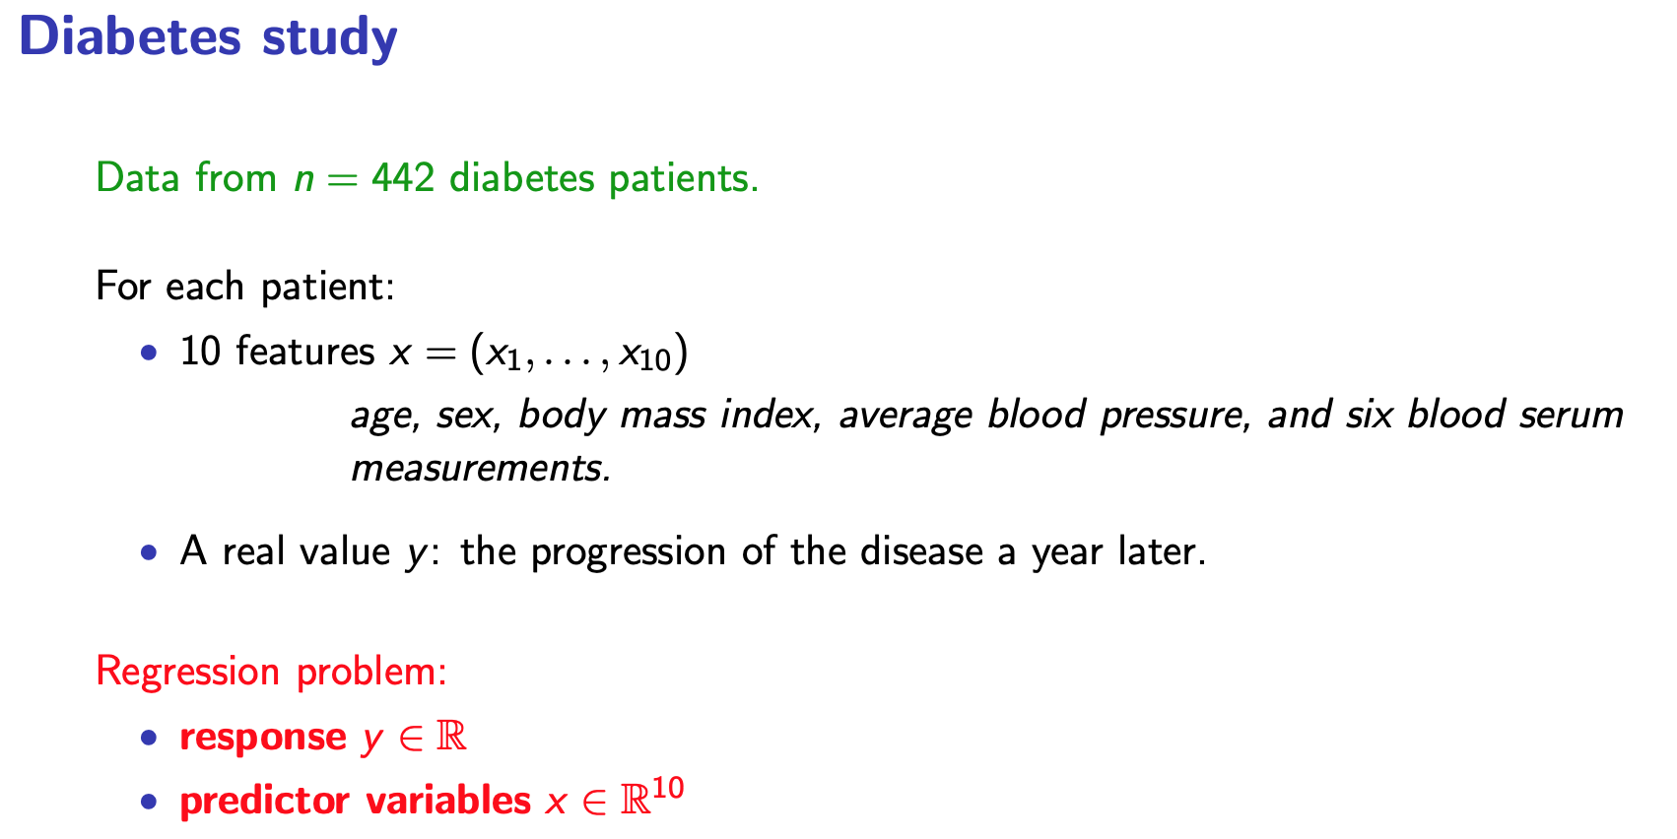

Slide 53
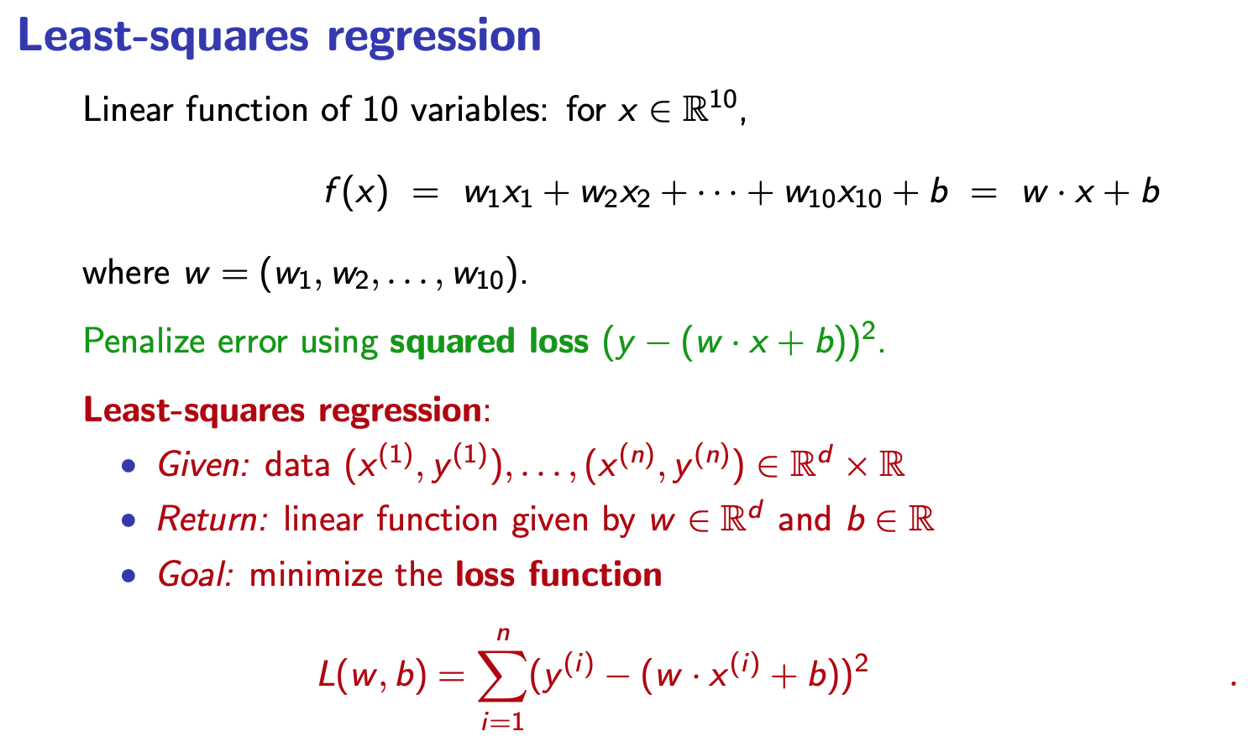

Slide 54
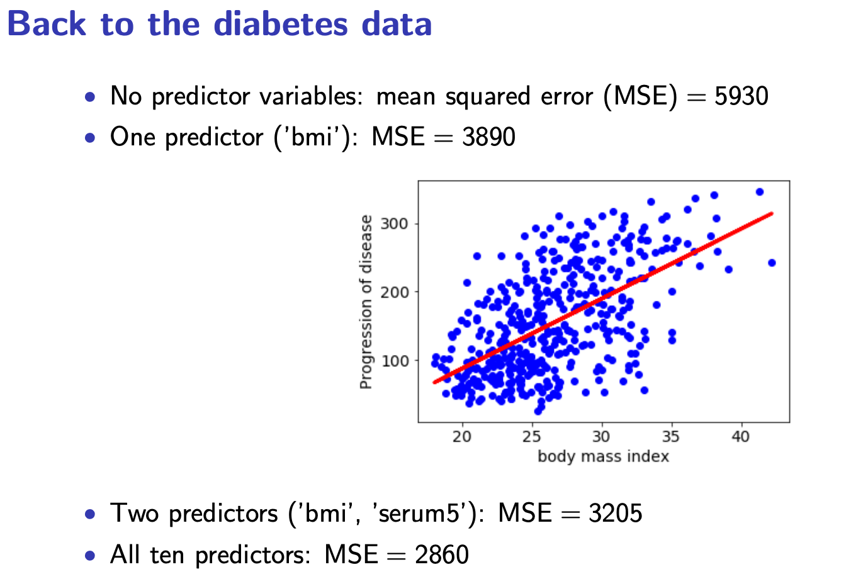

Slide 55
Linear Regression, Jupyter Notebook Walkthrough
https://github.com/waqarahmed1/NVIDIA/blob/main/Machine-Learning-Basics/1.%20Linear%20Regression.ipynb

Slide 56
Logistic Regression
Topics covered
Logistic Regression Explained
The logistic regression model
Loss function properties
Solution by gradient descent

Slide 57
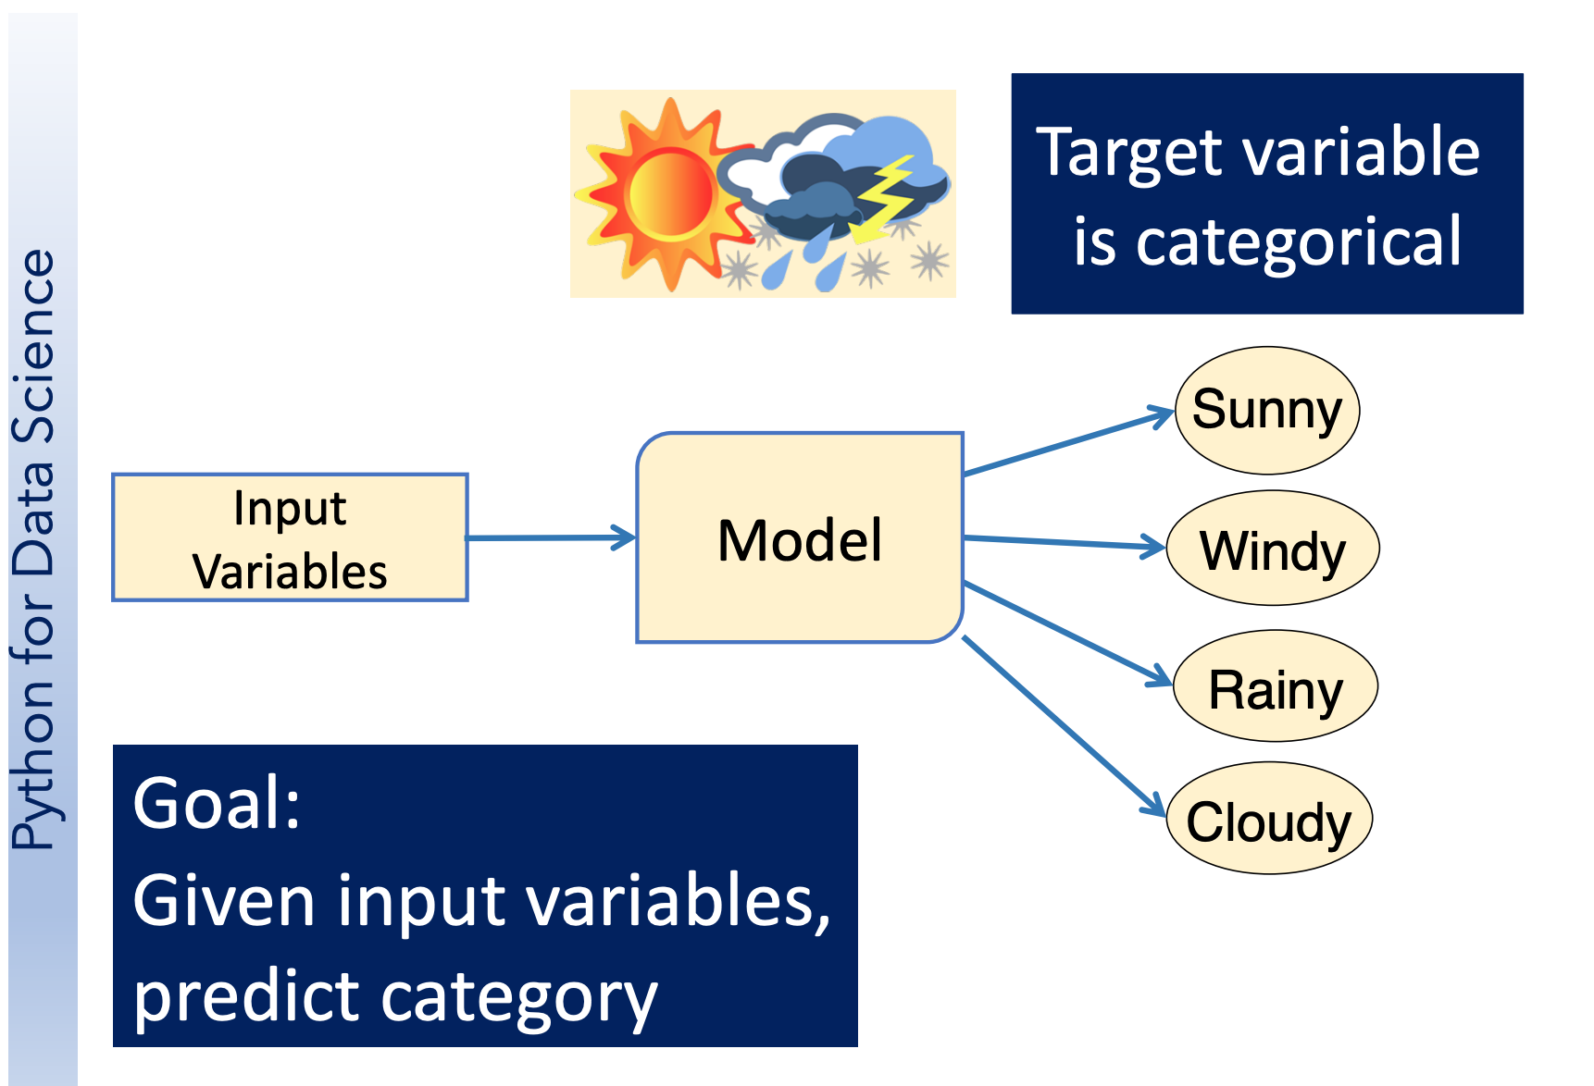

Slide 58
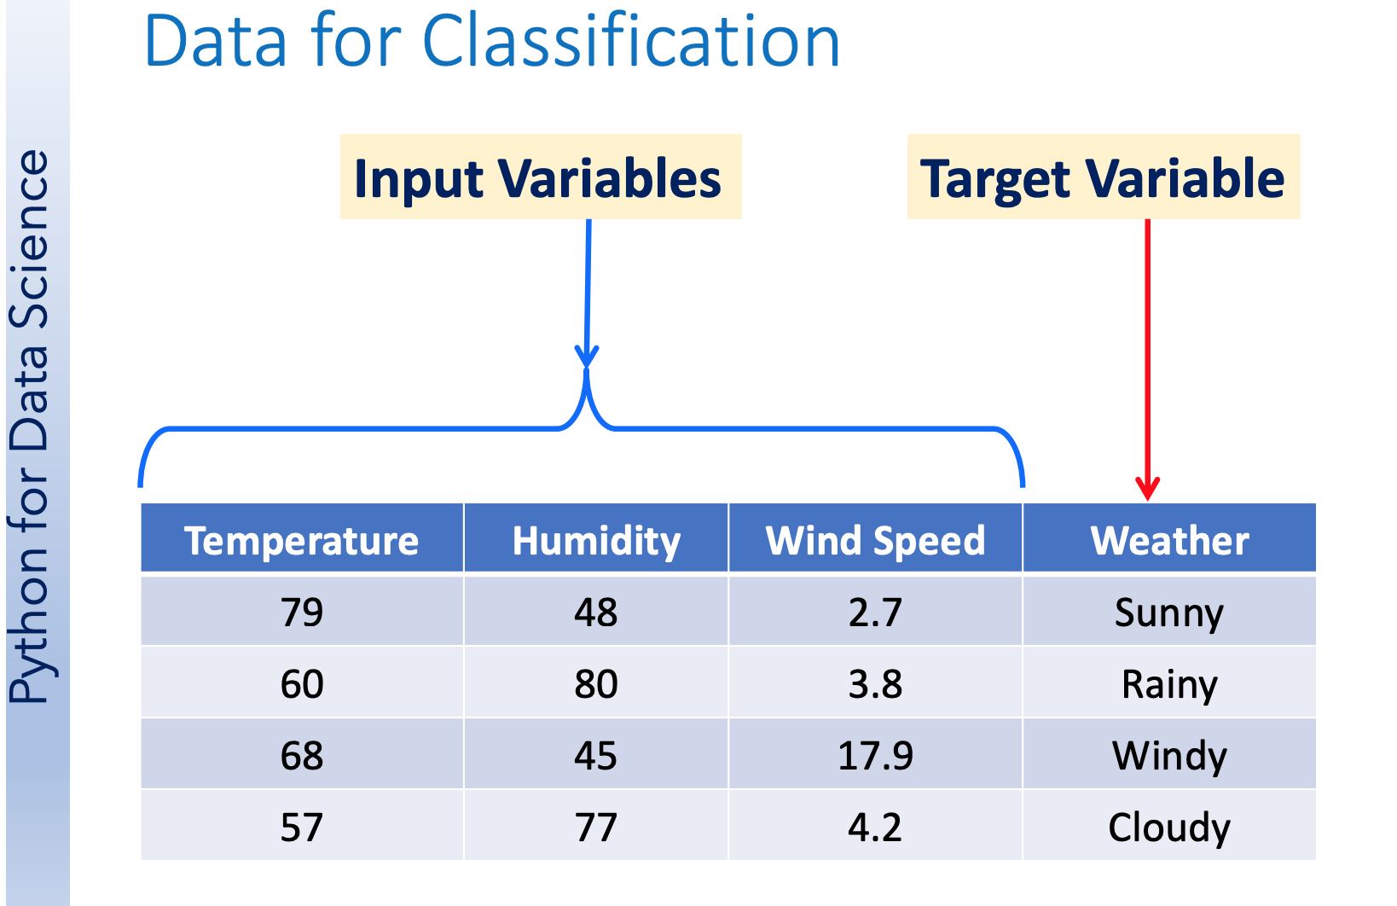

Slide 59
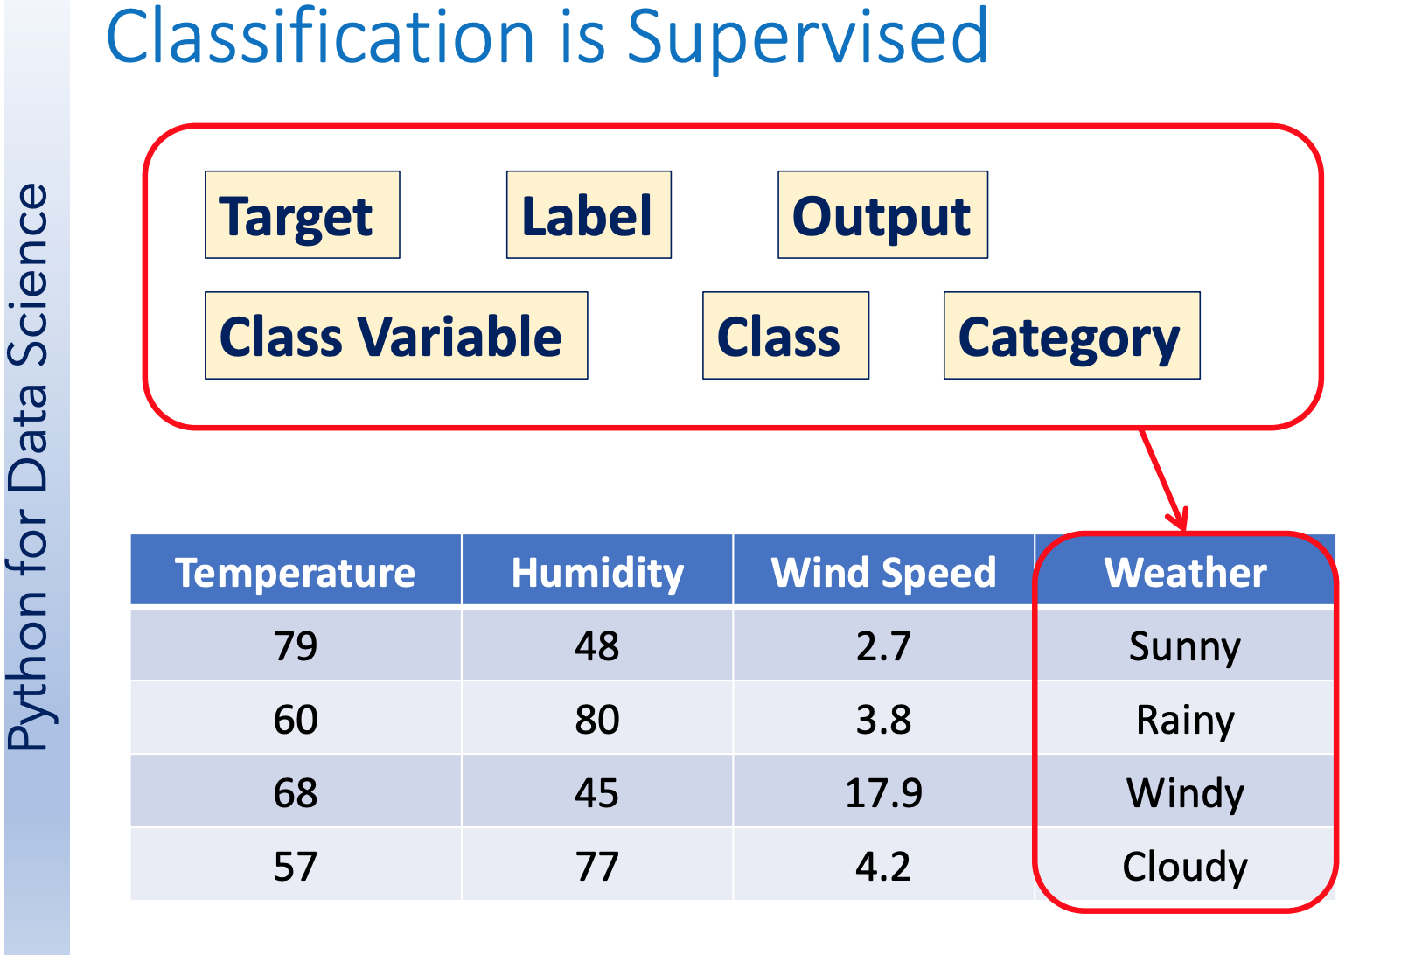

Slide 60
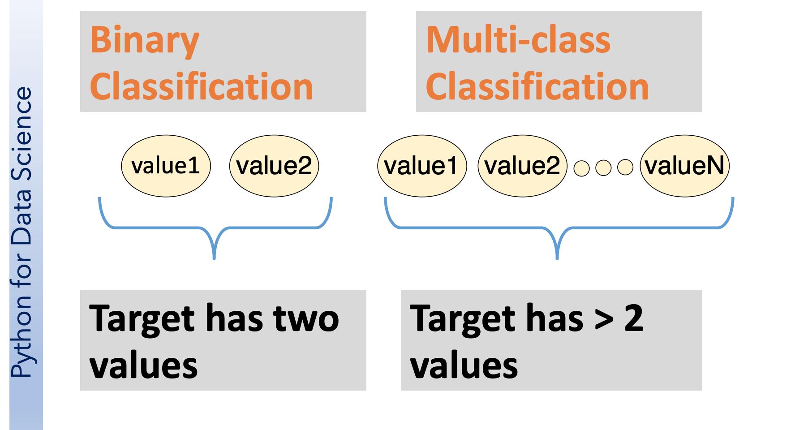

Slide 61
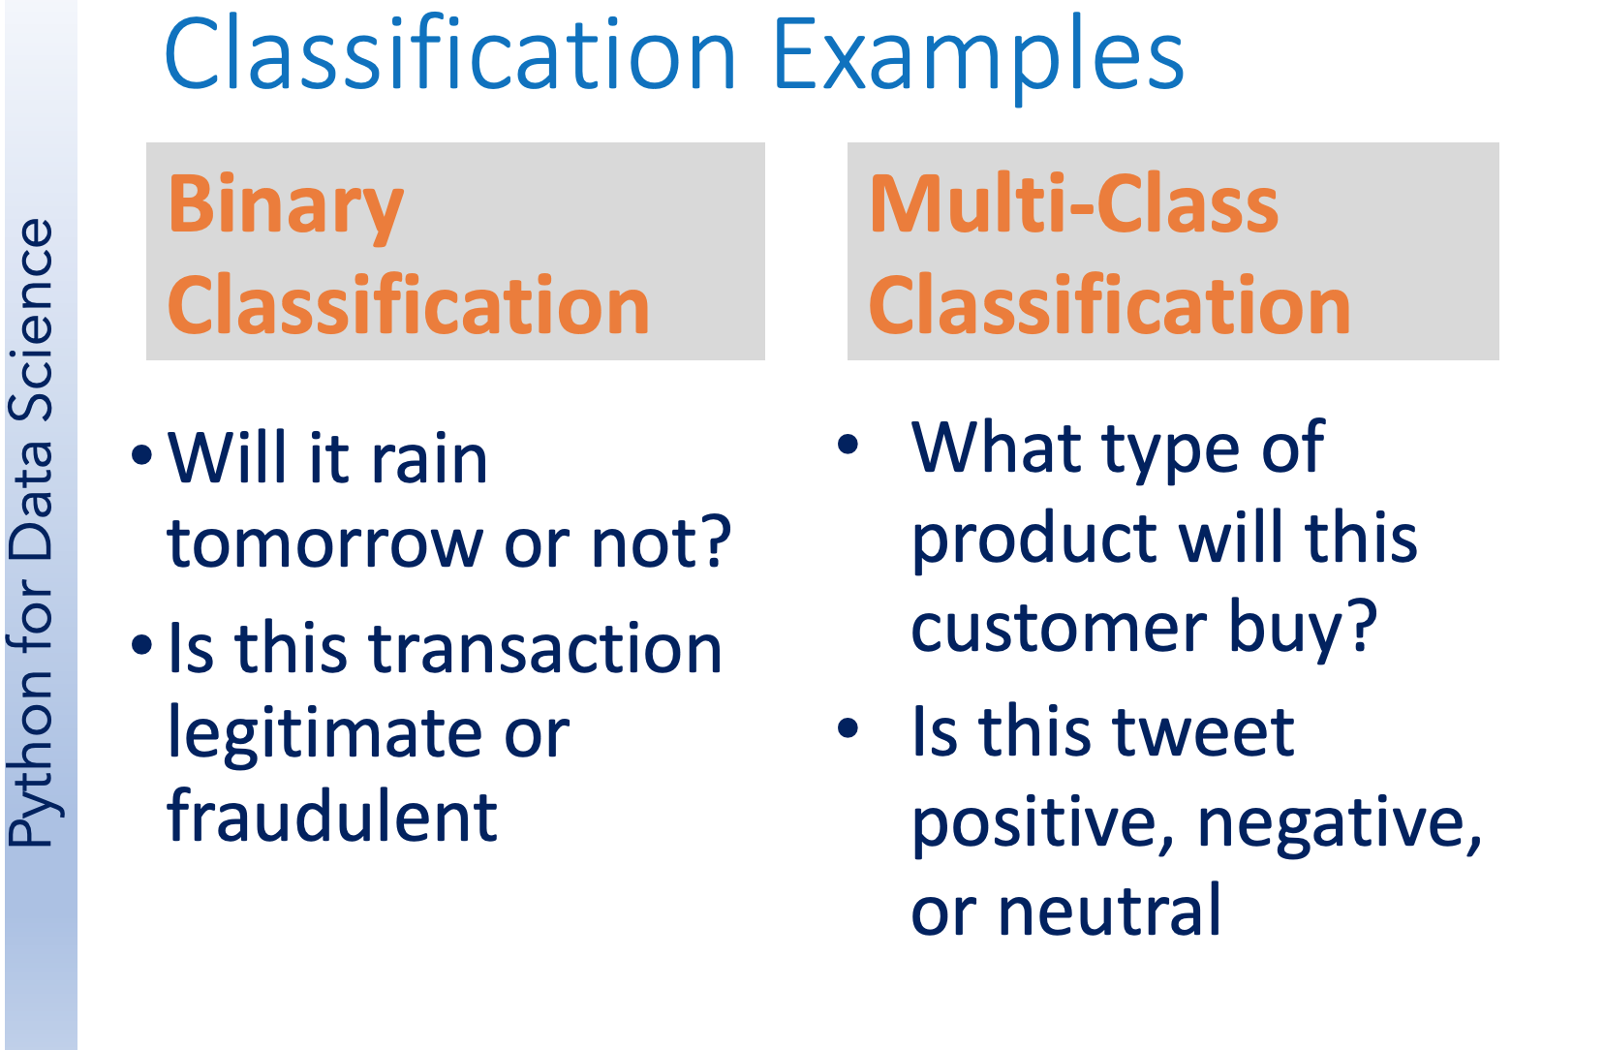

Slide 62
Logistic Regression - Explained
Whiteboard
https://lucid.app/lucidspark

Slide 63
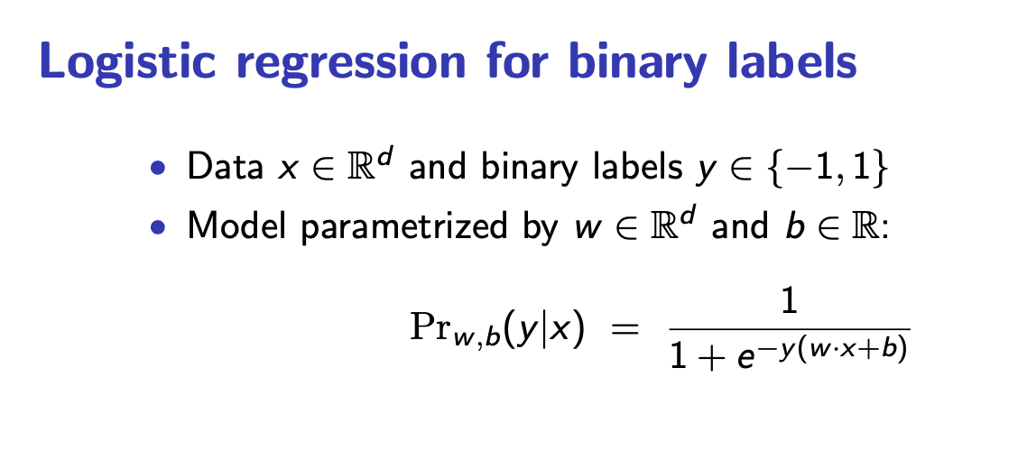

Slide 64


Slide 65


Slide 66


Slide 67


Slide 68
Logistic Regression, Jupyter Notebook Walkthrough
https://colab.research.google.com/github/diannekrouse/LRPython/blob/master/LogisticRegression.ipynb#scrollTo=adkqunikbhGd

Slide 69

Clustering Methods in ML

Slide 70


Slide 71


Slide 72


Slide 73

Distance
functions

Slide 74


Slide 75


Slide 76


Slide 77
Clustering, Jupyter Notebook Walkthrough
https://colab.research.google.com/github/csmastersUH/data_analysis_with_python_spring_2020/blob/master/clustering.ipynb#scrollTo=LtoNqvGhy_gV

Slide 78

Ensemble Learning Techniques

Slide 79


Slide 80


Slide 81


Slide 82
Boosting
Used in supervised methods , regression and classification. To reduce bias improve accuracy and stability of model.
Aims to minimise training errors. Metaheuristic approach, ensemble based.
XGBoost is a very popular example.

Slide 83


Slide 84


Slide 85
Mathematical Underpinnings of ML
Key areas of mathematics required for machine learning
Linear Algebra
Probability & Statistics
Optimisation

Slide 86
Mathematical Underpinnings of ML
Sets
Relations
Operations
Cartesian products
Combinatorics
Permutations
Combinations
Binomials
Multinomials
Conditional probability
Repeated experiments
Independence
Sequential probability
Total probability
Bayes’ rule

Slide 87
Mathematical Underpinnings of ML
Heavy use of distributions to model probabilities. Good understanding of various distribution families:
Discrete
Bernoulli
Binomial
Possion
Geometric
Continuous
Uniform
Exponential
Gaussian

Slide 88
Mathematical Underpinnings of ML
Inequalities and limit theorem
Markov inequalities
Chebyshev inequalities
Law of large numbers
Moment generating functions
Chernoff bound
Central limit theorem

Slide 89
Mathematical Underpinnings of ML
Regression and Principal Component Analysis (PCA)
Understand matrices and vectors
Walkthrough notebook 4.PCA.ipynb

Slide 90
Large Language Models (LLM)
Language Model: Probability of distribution across tokens/words.
p(x1…x2)
P(the,dog,jumped,over,the,fence) = 0.03
P(the,dog,dog,jumped,over,the,fence) = 0.0001 (syntactical )
P(the,fence,jumped,over,the,dog) = 0.001 (semantic)

Slide 91
Large Language Models (LLM)
LM’s are Generative
Autoregressive (AR) language models
Decompose distribution of a sentence and decompose to probability of composition of word combinations of sentence.
p(X1, … ,XL )= p(X1)P(X2|X1)P(X3|X2,X1) ….
Chain rule of probability (No approx.)
The model is predicting the next token given
the past context !

Slide 92
Large Language Models (LLM)
Autoregressive
One way to model distribution for models, many other approaches
Regular runs of training and inference require operational process to support this and thought around strategy.
Establishing pipelines
Monitoring LLMs
Hardware intensive processes, infrastructure strategy
Create eco system that allows quick prototyping of ideas. Through processes for data curation and feature engineering processes.

Slide 93
LLM Experimentation
Choose between online or batch processes for running inference.
Create reusable artifacts for varying experimentations to speed up process.
Utilise Low code/No code solutions as scientists to run experimentation.

Slide 94
Lab Session
LAB 3 - Modelling Protein Detectability on Mass Spectrometry with MLP Algorithm
https://colab.research.google.com/drive/1tXJbxi7O93guCJeEIC3ofC7XIeEGdoBl#scrollTo=4acfe790

Slide 95
Thank You

Slide 96
Contents Lab Sessions
LAB 1 - Protein Structure Prediction using ESMFold
First notebook second notebook
LAB 2 - Physicochemical Properties Analysis of Protein Sequence Data
https://colab.research.google.com/drive/1mdL5pJHk7IJZKC893MtemXI9Dqt_0Xug?usp=sharing
LAB 3 - Modelling Protein Detectability on Mass Spectrometry with MLP Algorithm
https://colab.research.google.com/drive/1tXJbxi7O93guCJeEIC3ofC7XIeEGdoBl#scrollTo=4acfe790

